Slide 1
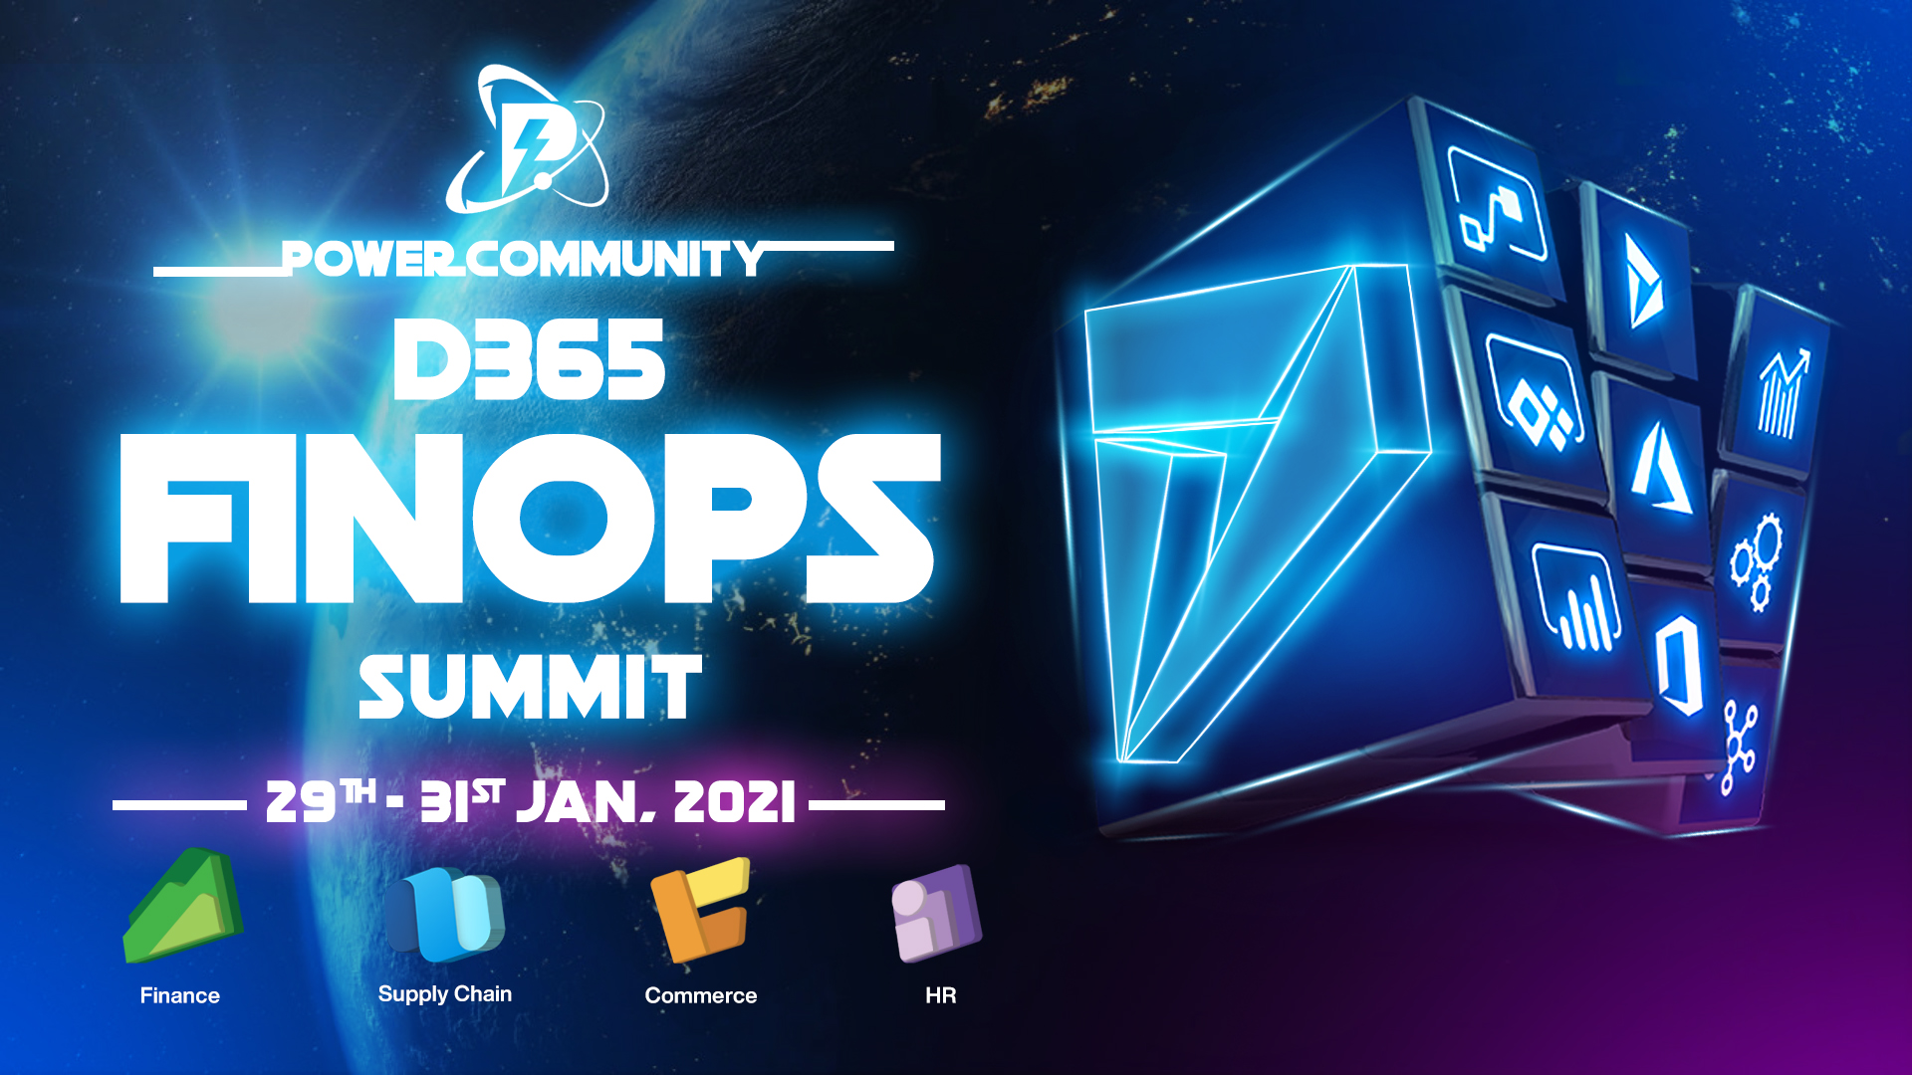

Slide 2
LCS Administration for Upgrades and Implementations

Slide 3

Nathan Clouse
Technical Architect, Microsoft Business Applications MVP
Technical Architect enVista Corp.
Microsoft Business Applications MVP nclouse@envistacorp.com www.atomicax.com
@NathanClouseAX

Slide 4
Topics
The Upgrade Experience
New Requirements
On Premise
Cloud
What’s New and Different
Managed Updates
Code Upgrade
Upgrade Analysis
Subscription Estimator
Onboarding
Asset Library
Project Settings
Work Items
Environments
Topologies and Tiers
Azure & Environments
Development
Management
Tools
BPM
Servicing
Analytics
Diagnostics
Environment Monitoring

Slide 5
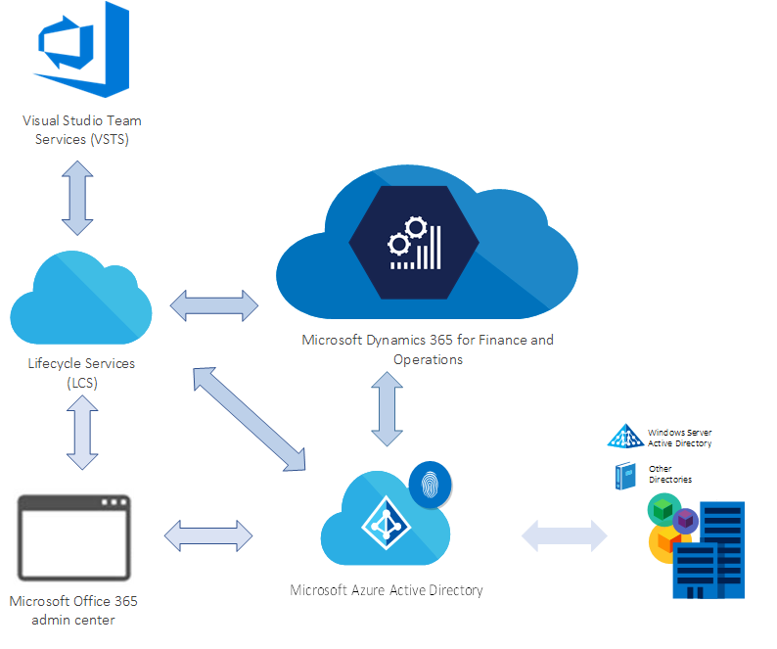
Overall Solution for D365FO
Notes:
Subscription
Licenses
Tenant, AAD
Azure DevOps
LCS is a collaboration portal that provides an environment and a set of regularly updated services that can help you manage the application lifecycle of your implementations. For more information, see Lifecycle Services resources. After you purchase and activate a subscription for a Finance and Operations app, an Implementation project workspace is provisioned in LCS when the tenant administrator signs in for the first time.

Slide 6

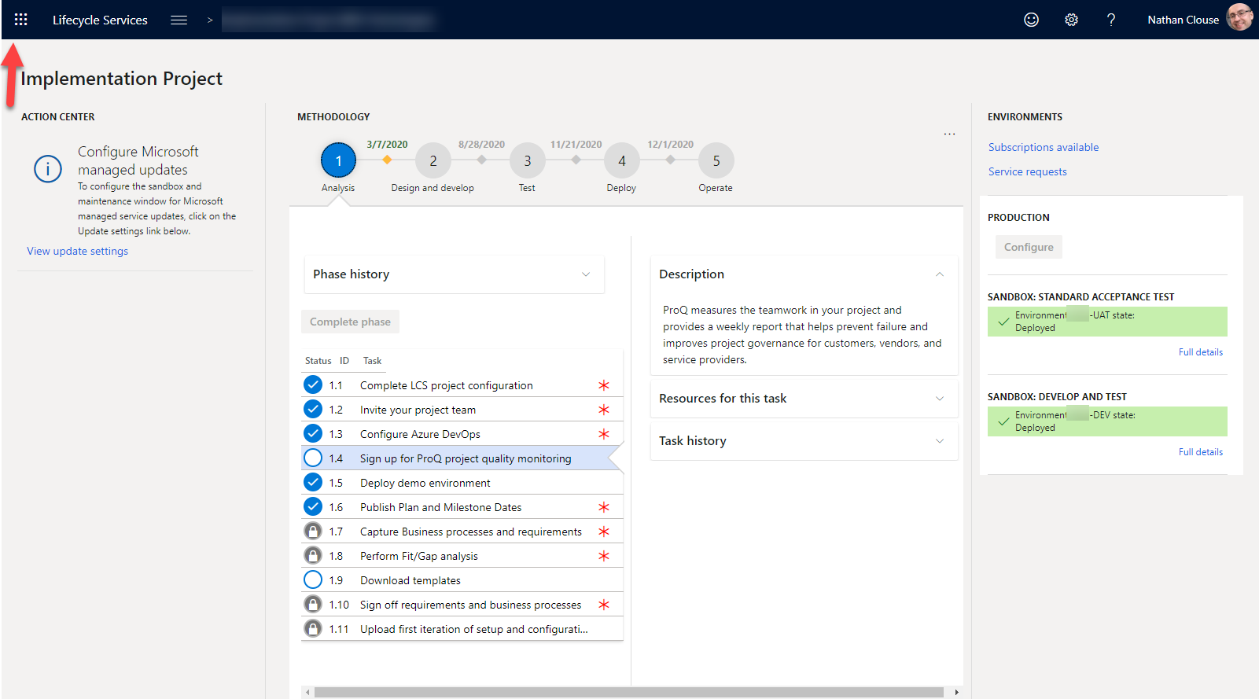
Waffle

Slide 7

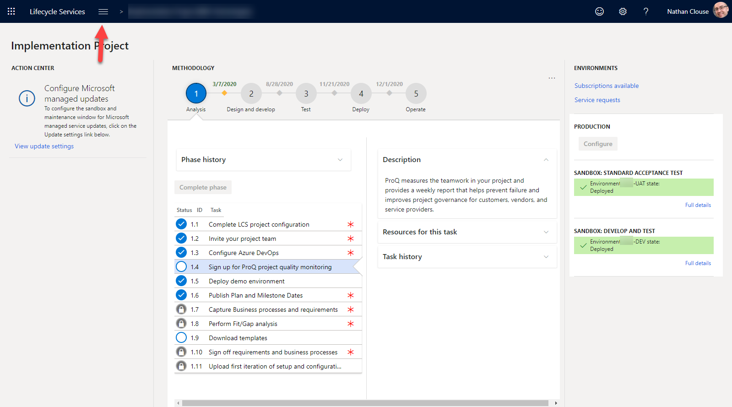
Hamburger
Notes:
ADMIRAL RADDUS AND ADMIRAL ACKBAR BOTH HAIL FROM WHICH PLANET? mon cala

Slide 8
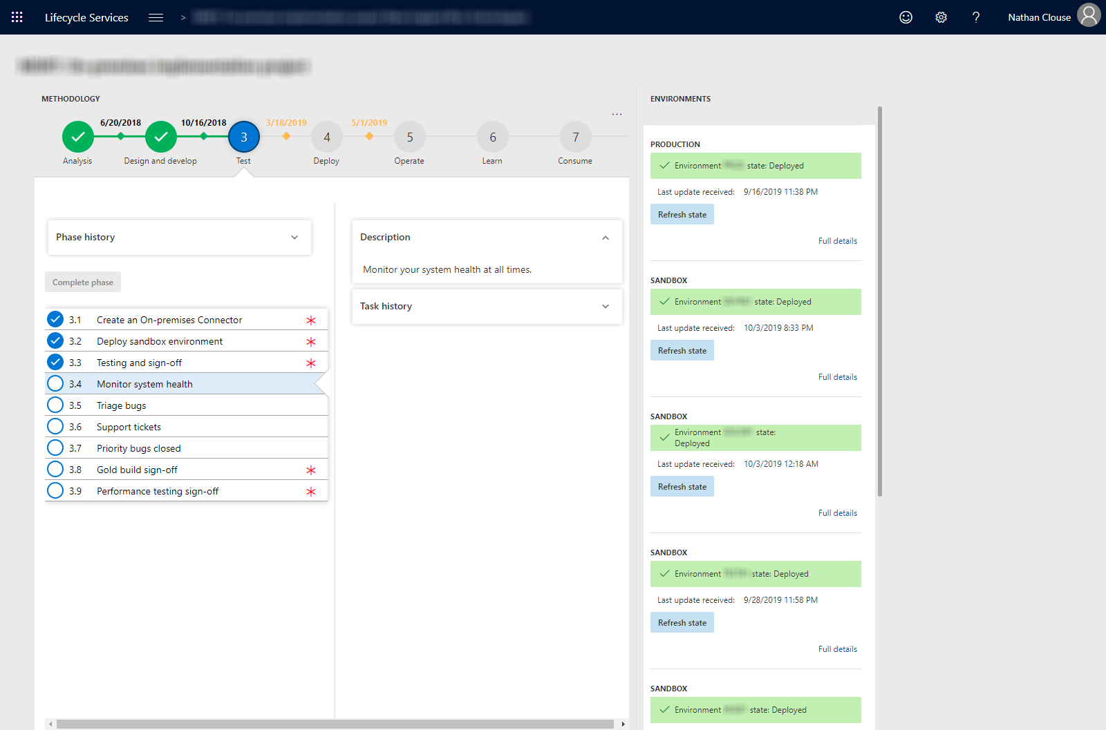
LCS Look and Feel – On Premise
Notes:
LCS look for on prem

Slide 9
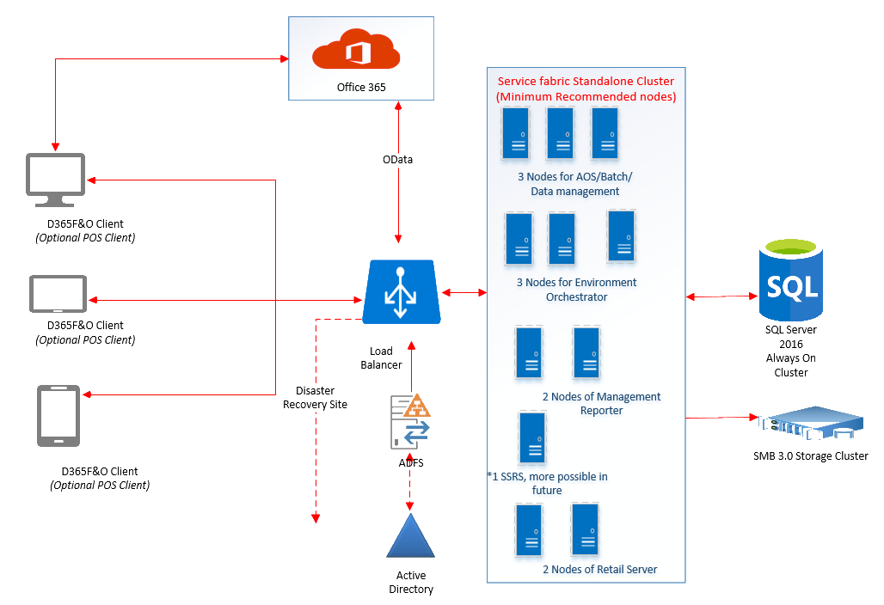
Sample On Premise Architecture
Notes:
Lots of time and hardware
expensive

Slide 10
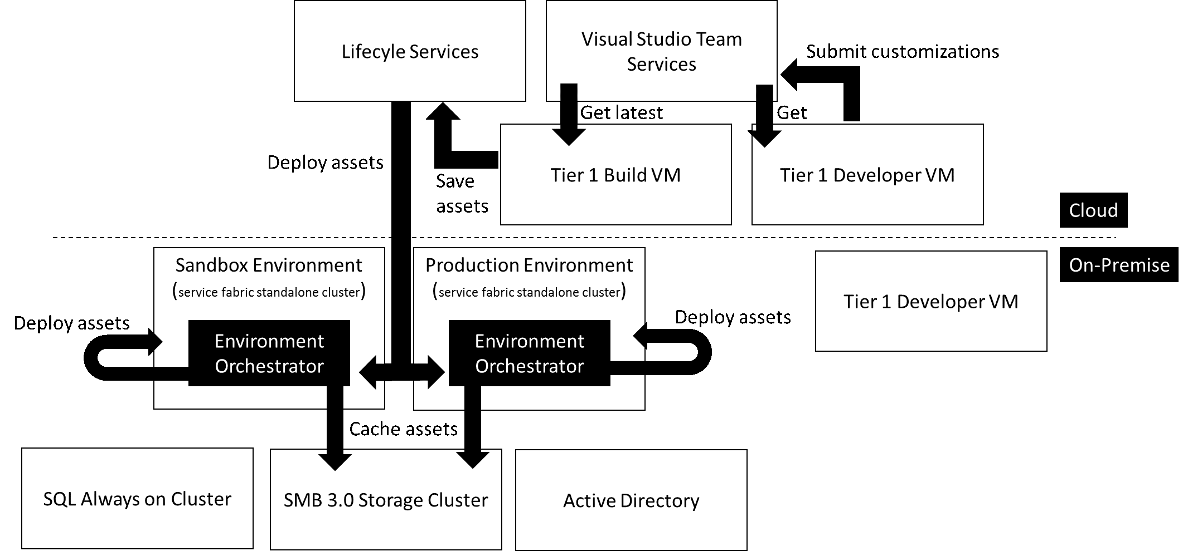

Slide 11
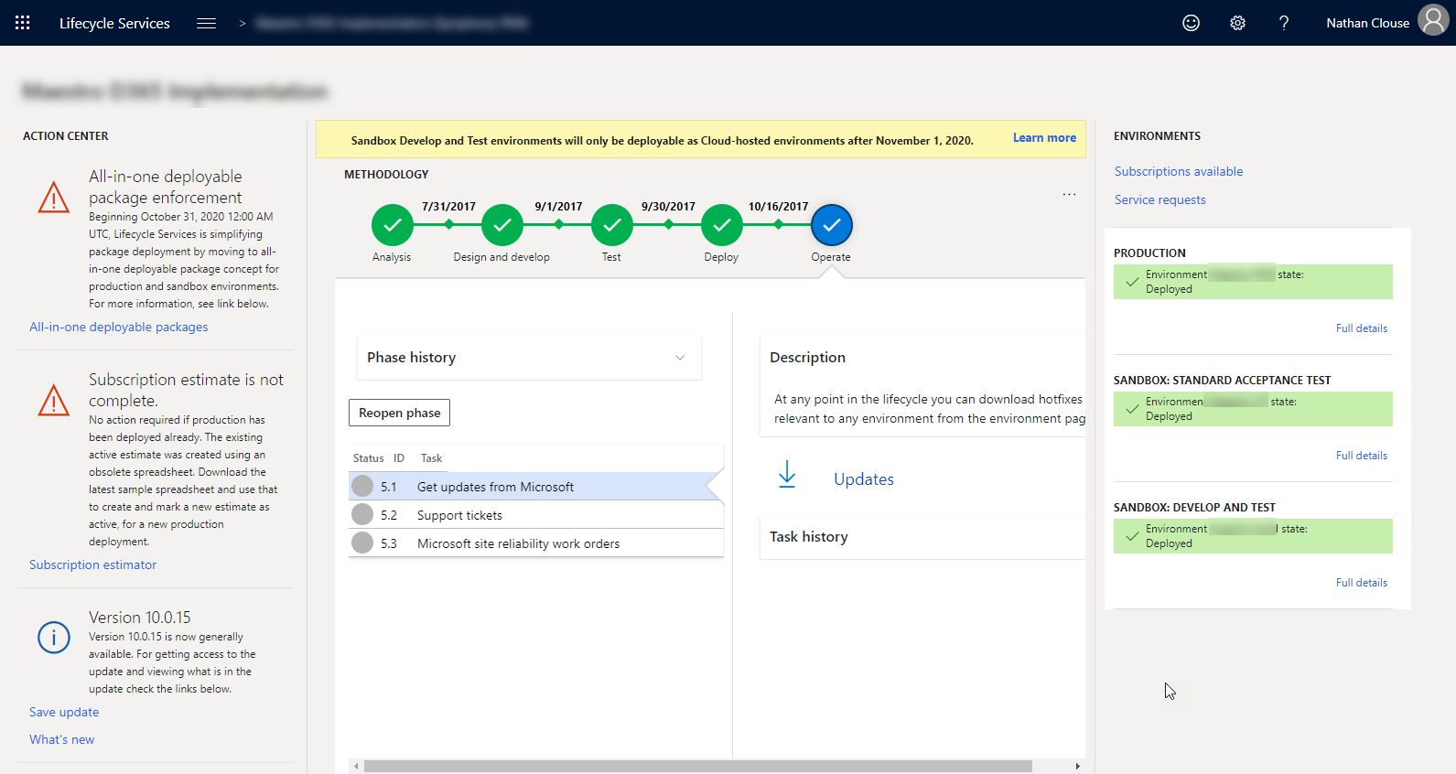
LCS Look and Feel - Cloud
Notes:
What LCS looks like for the cloud

Slide 12
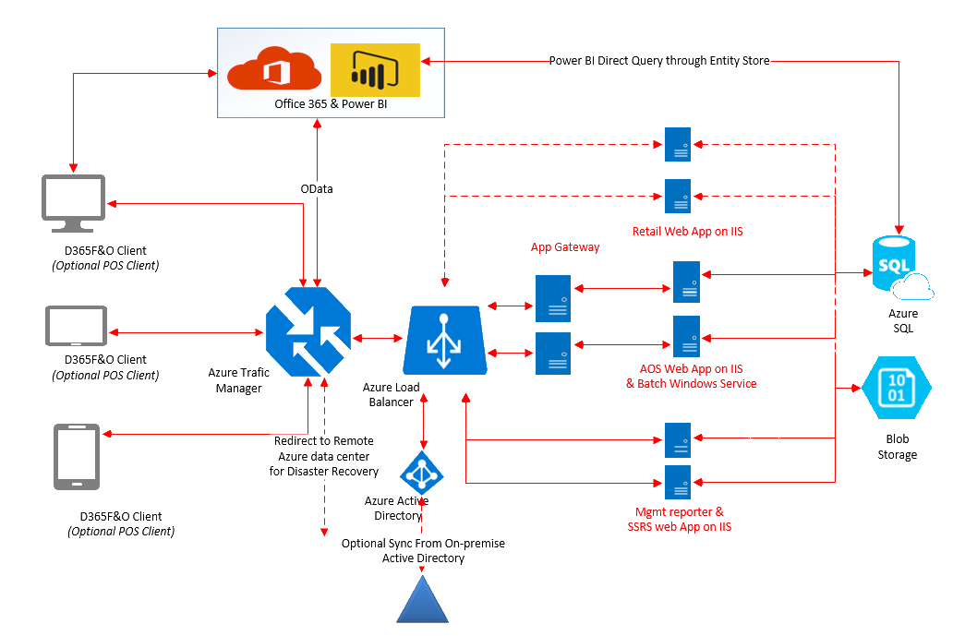
Cloud Architecture (Old)

Slide 13
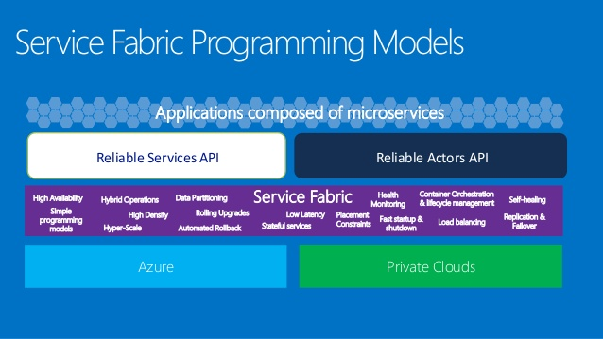
Cloud Architecture (New)

Slide 14
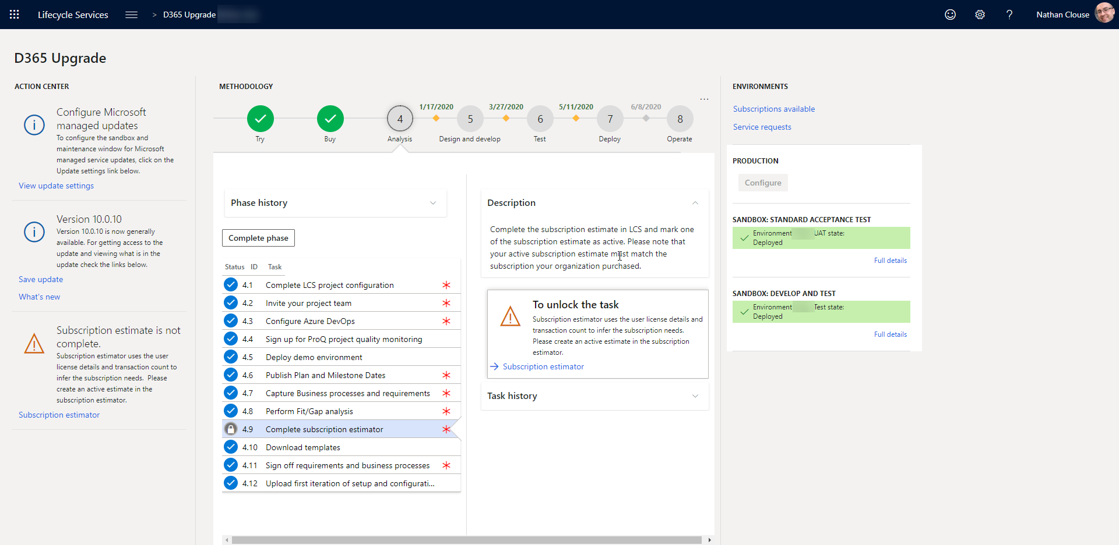
What’s New and Different
Notes:
This is LCS project home screen
Action center on left, environments and quick links on the right
Main project methodology and time line in the center

Slide 15
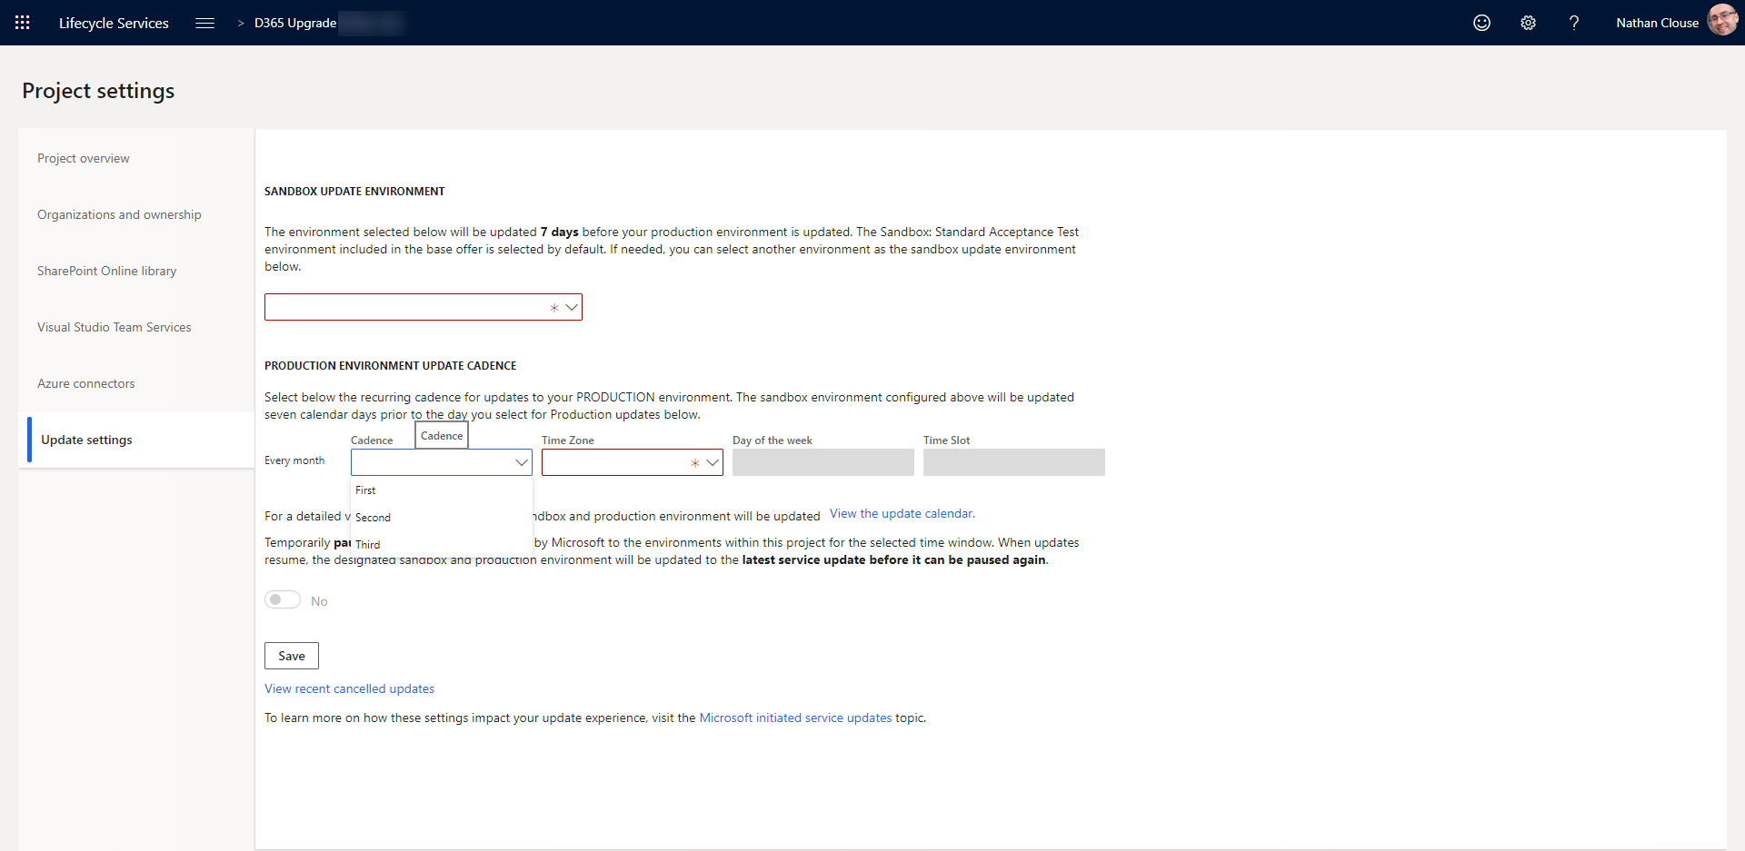
Scheduled Updates
Notes:
You pick the schedule
Skip updates up to 2 times if needed

Slide 16
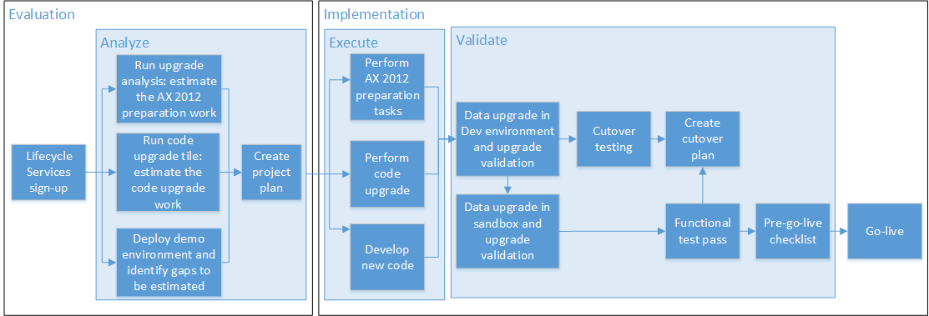
Upgrade Tools

Slide 17
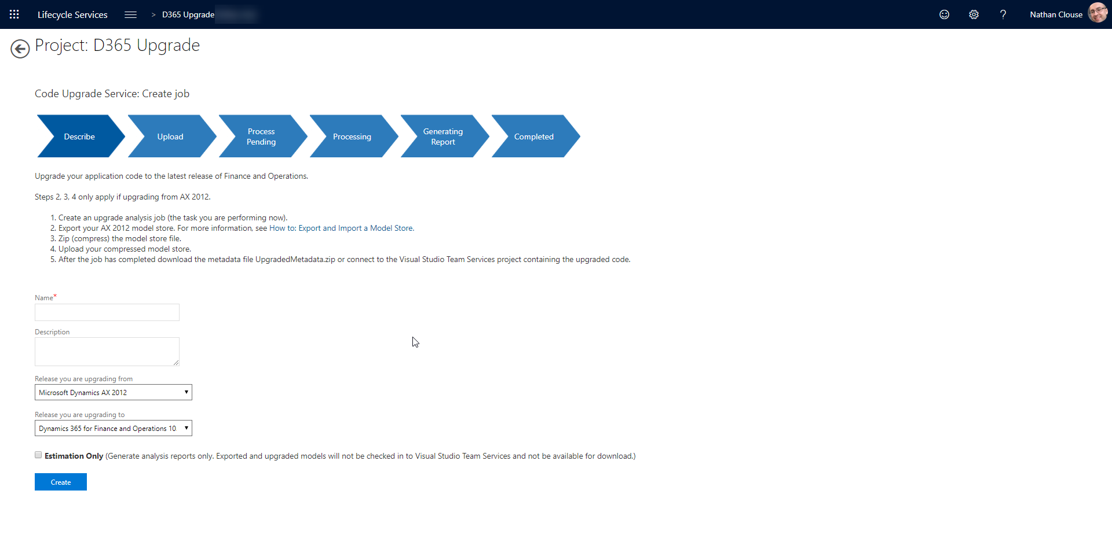
Code Upgrade
Notes:
Create an upgrade analysis job (the task you are performing now).
Export your AX 2012 model store. For more information, see How to: Export and Import a Model Store.
Zip (compress) the model store file.
Upload your compressed model store.
After the job has completed download the metadata file UpgradedMetadata.zip or connect to the Visual Studio Team Services project containing the upgraded code.

Slide 18
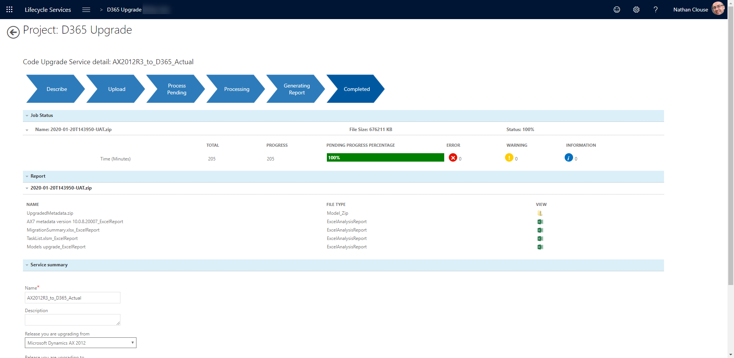
Code Upgrade (cont.)

Slide 19
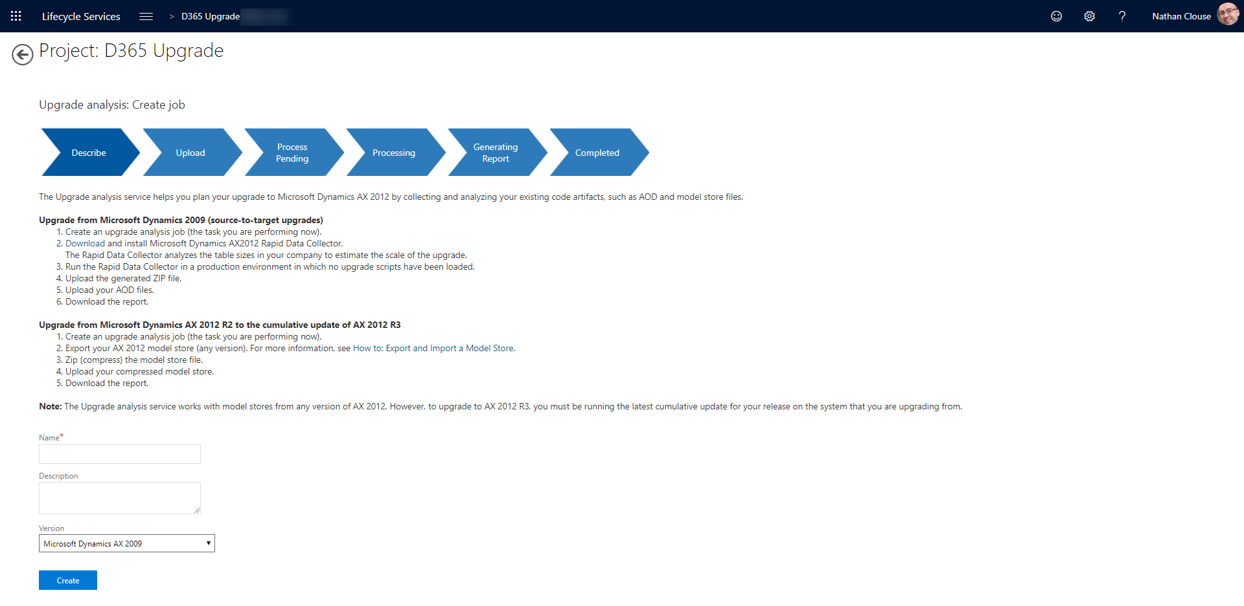
Upgrade Analysis
Notes:
Upgrade from Microsoft Dynamics 2009 (source-to-target upgrades)
Create an upgrade analysis job (the task you are performing now).
Download and install Microsoft Dynamics AX2012 Rapid Data Collector. The Rapid Data Collector analyzes the table sizes in your company to estimate the scale of the upgrade.
Run the Rapid Data Collector in a production environment in which no upgrade scripts have been loaded.
Upload the generated ZIP file.
Upload your AOD files.
Download the report.
Upgrade from Microsoft Dynamics AX 2012 R2 to the cumulative update of AX 2012 R3
Create an upgrade analysis job (the task you are performing now).
Export your AX 2012 model store (any version). For more information, see How to: Export and Import a Model Store.
Zip (compress) the model store file.
Upload your compressed model store.
Download the report.

Slide 20
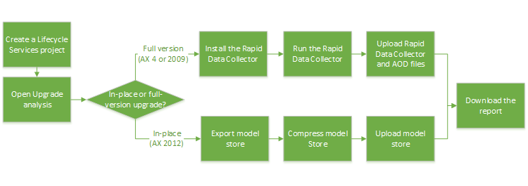
Upgrade Analysis
Notes:
Similar to code upgrade
Helps plan your upgrade by collecting and analyzing 2012 code artifacts
Just a report

Slide 21
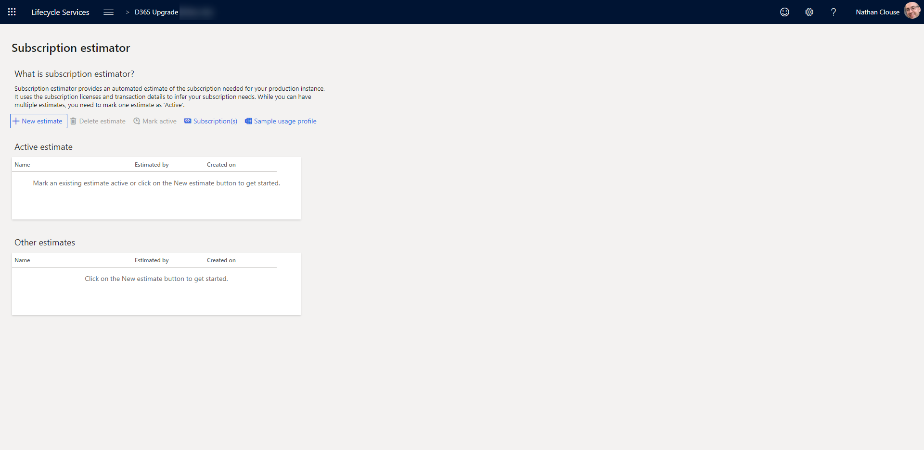
Subscription Estimator

Slide 22
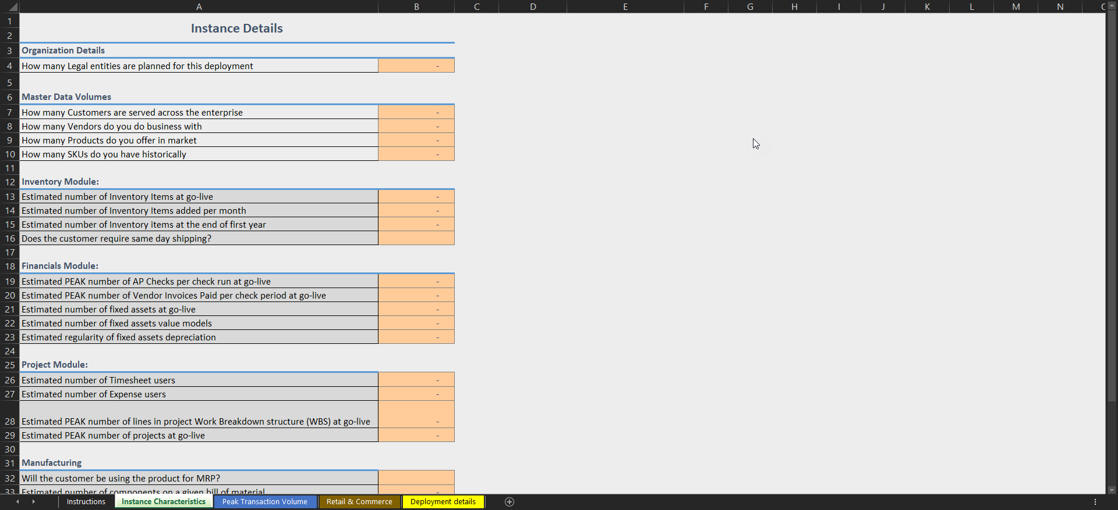
Subscription Estimator

Slide 23
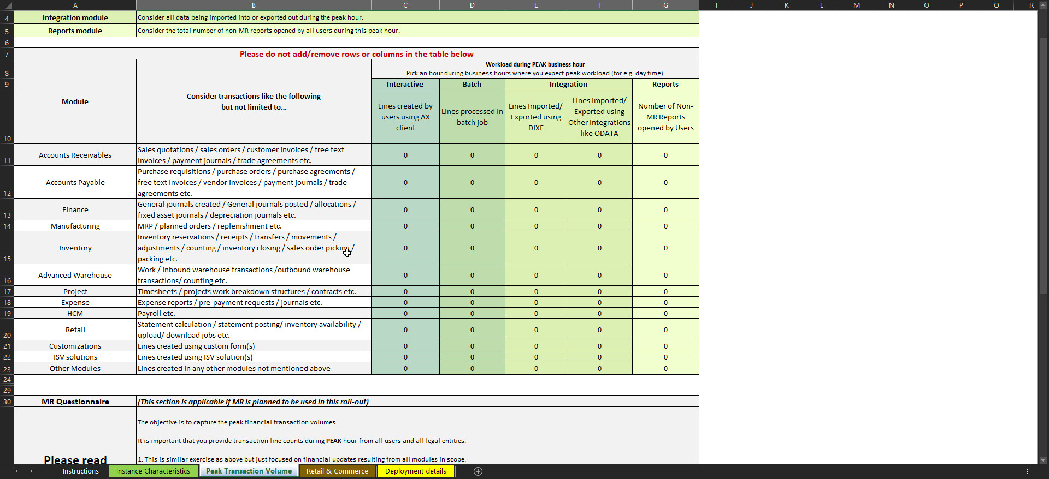
Subscription Estimator

Slide 24
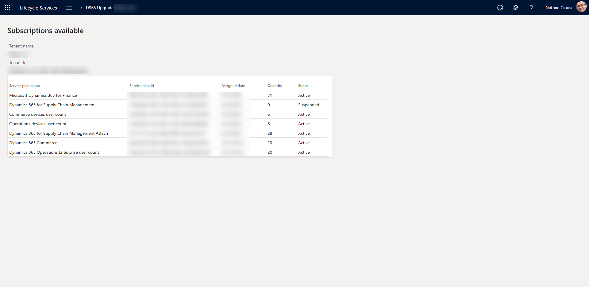
Subscriptions

Slide 25
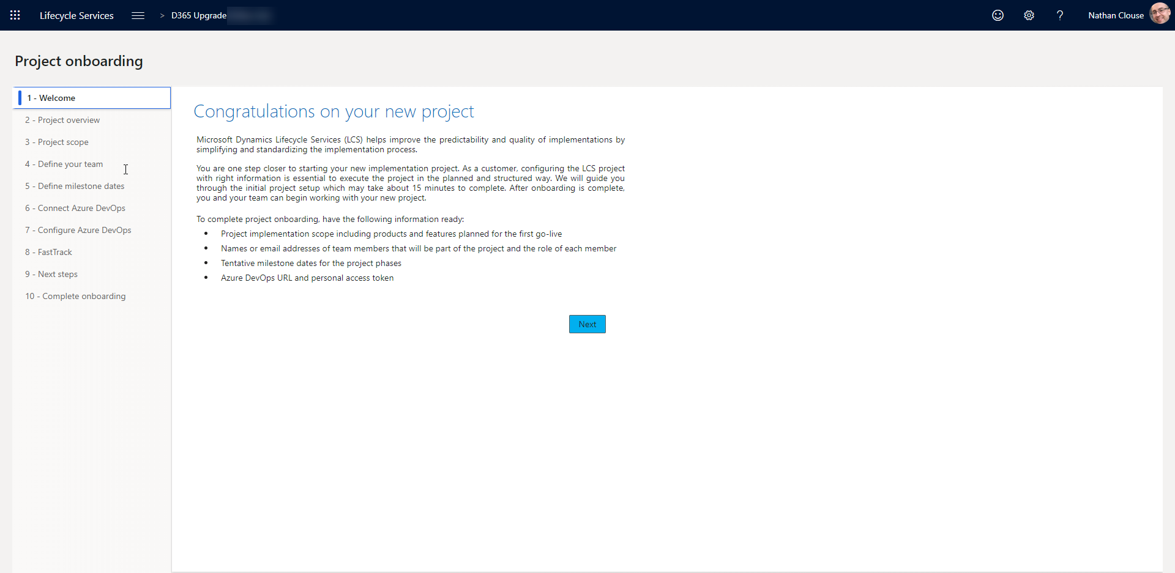
Onboarding

Slide 26
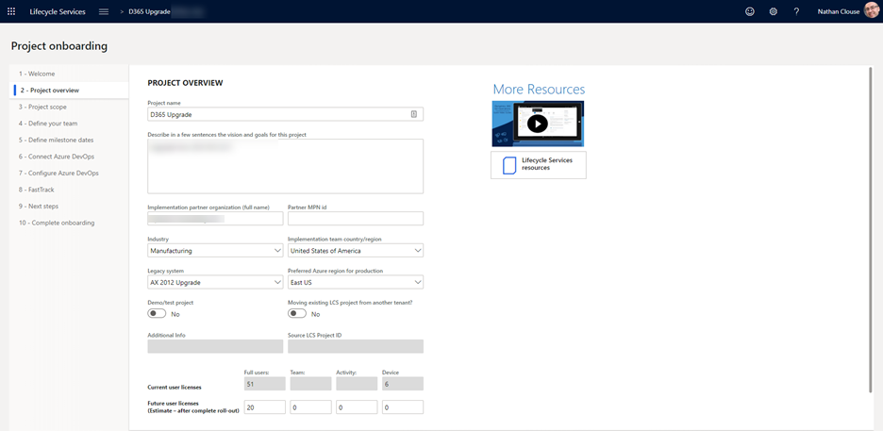
Onboarding (cont.)

Slide 27
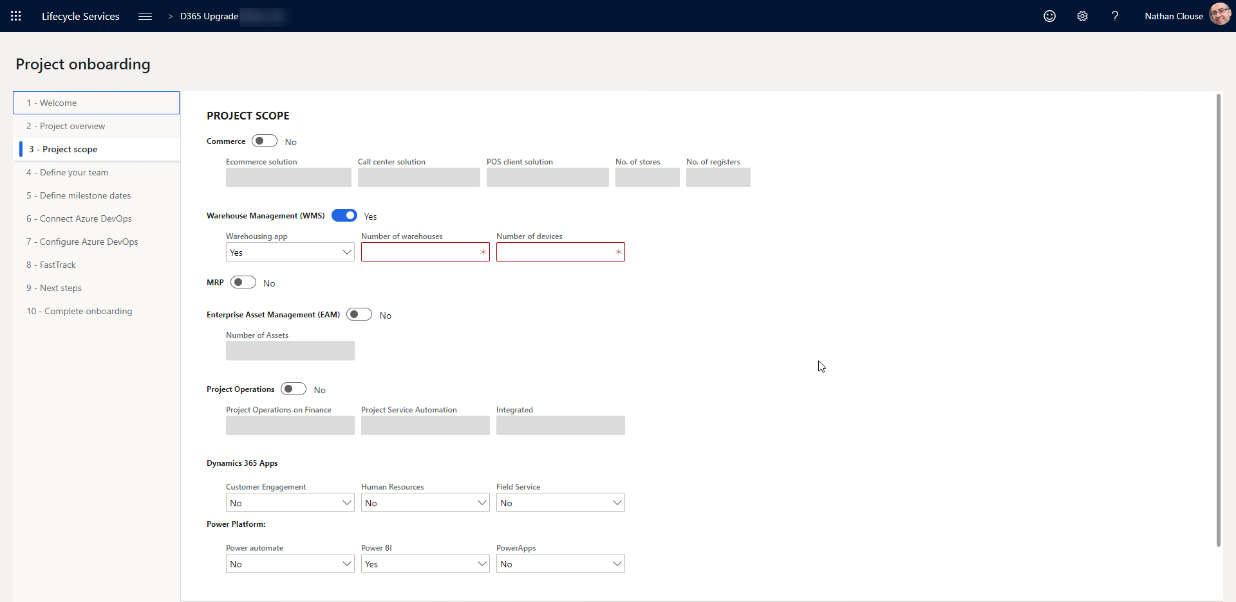
Onboarding (cont.)

Slide 28
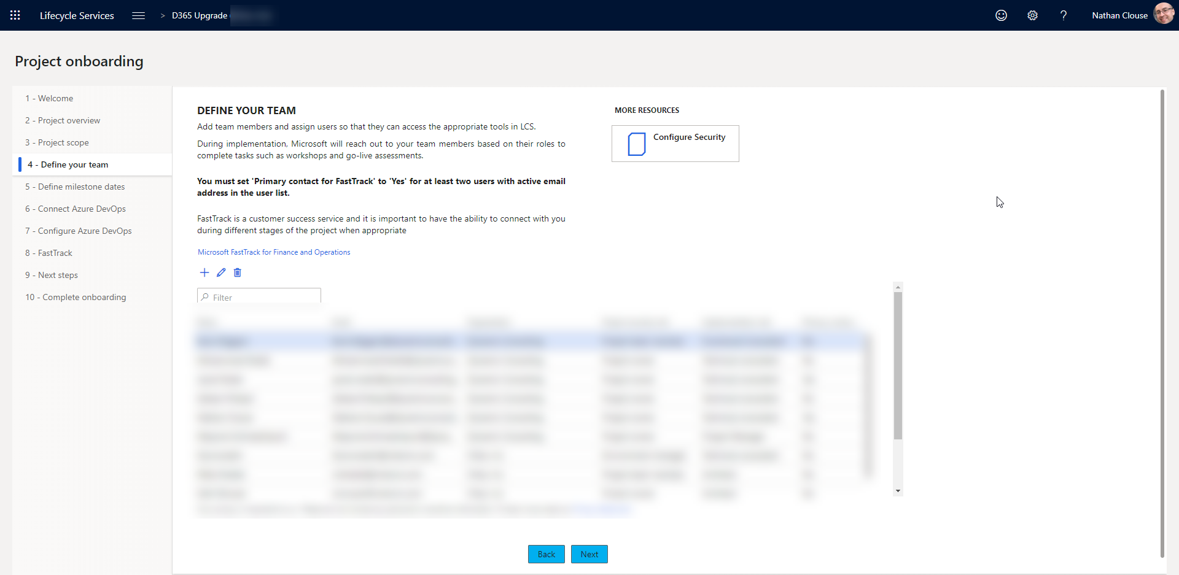
Onboarding (cont.)

Slide 29
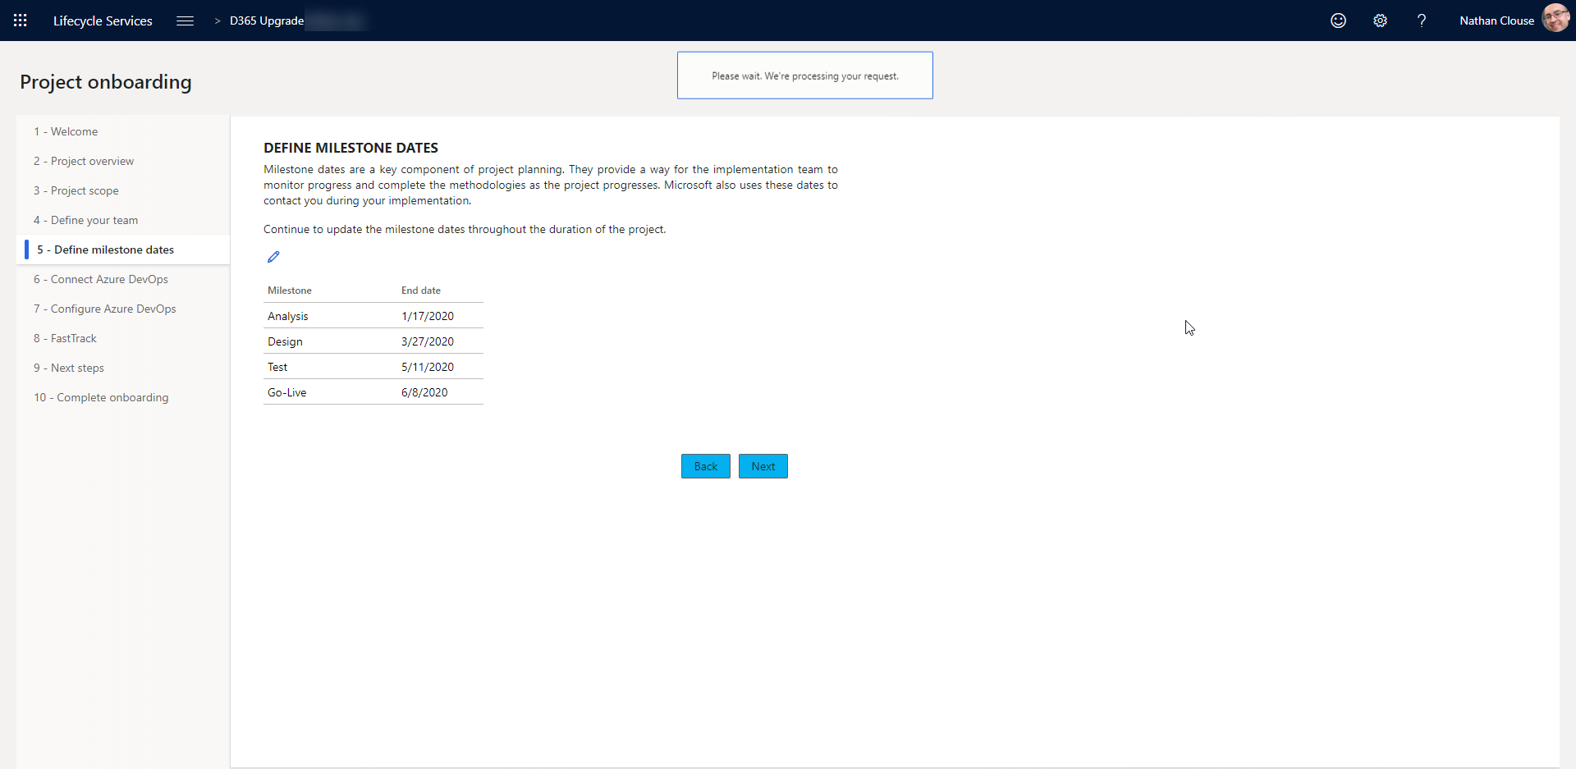
Onboarding (cont.)

Slide 30
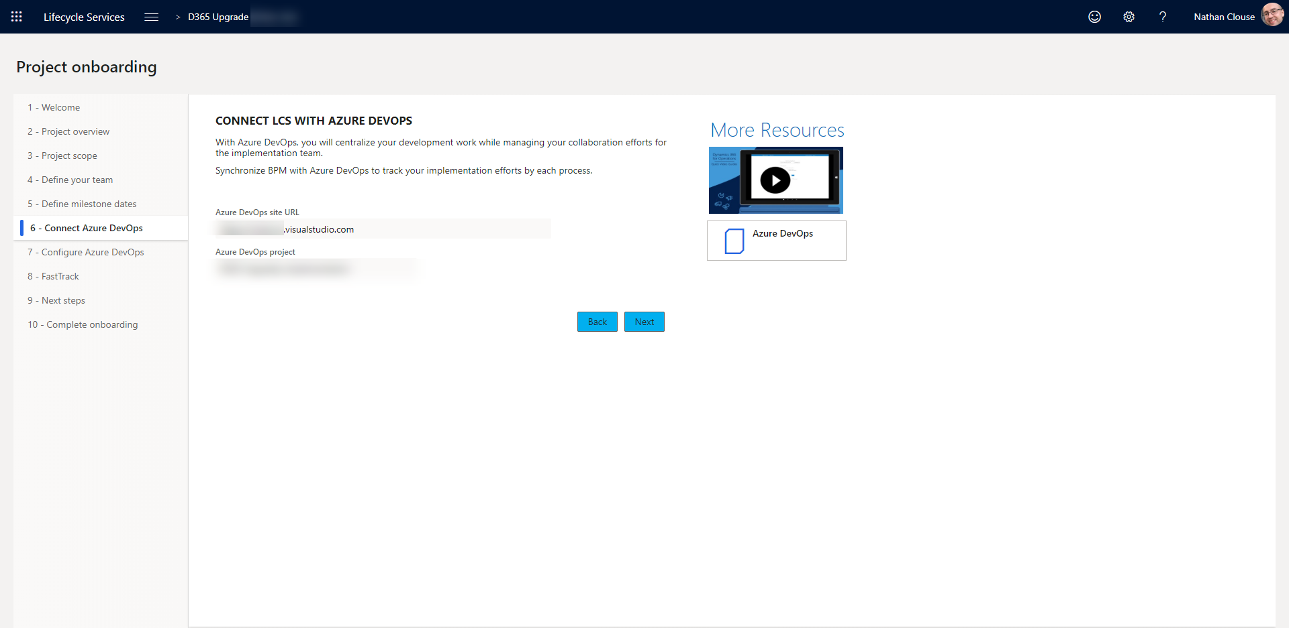
Onboarding (cont.)

Slide 31
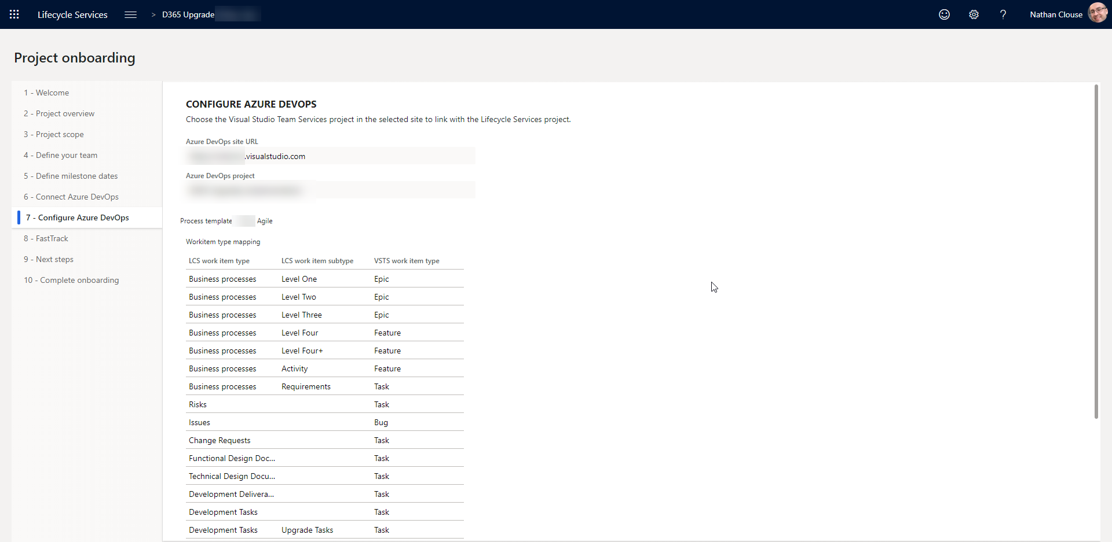
Onboarding (cont.)

Slide 32
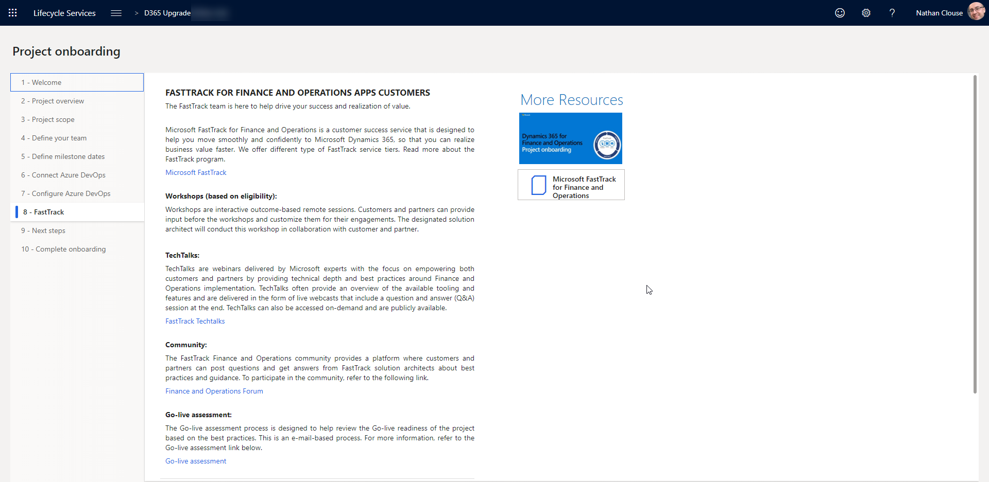
Onboarding (cont.)

Slide 33
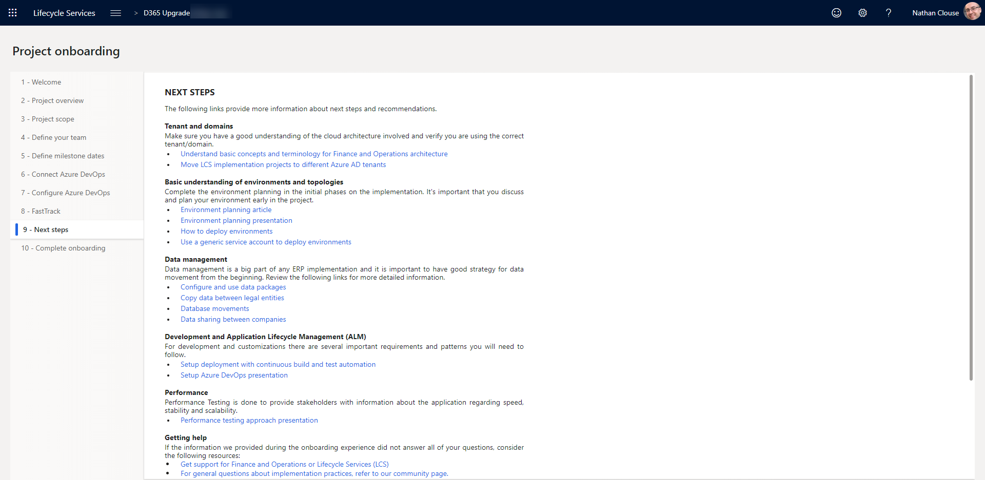
Onboarding (cont.)

Slide 34
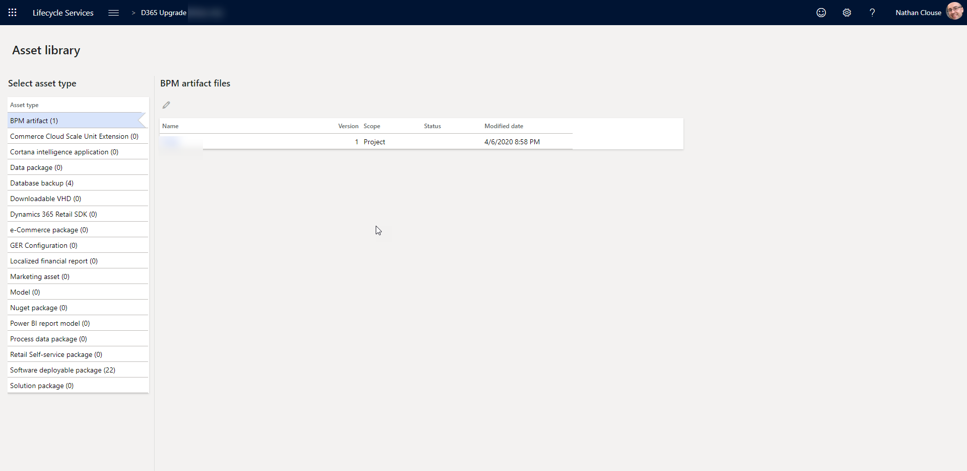
Asset Library

Slide 35
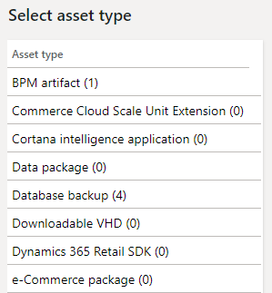
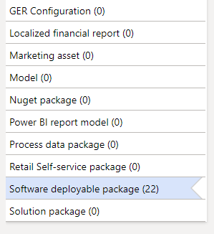
Asset Library (cont.)

Slide 36
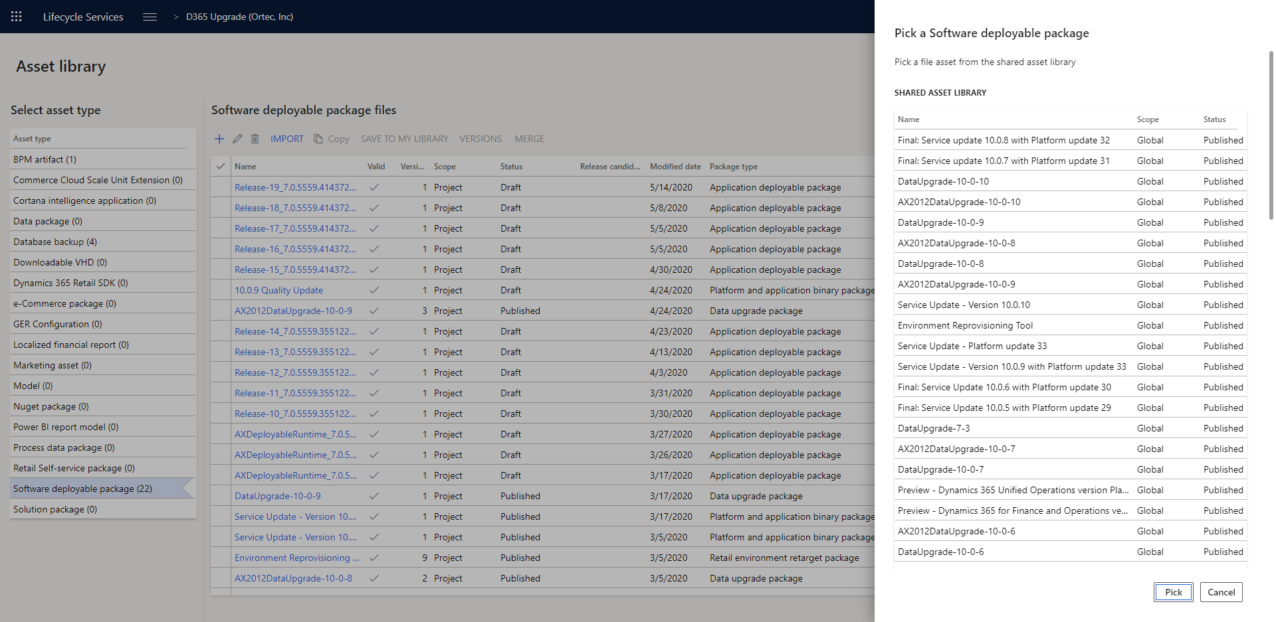
Asset Library (cont.)

Slide 37
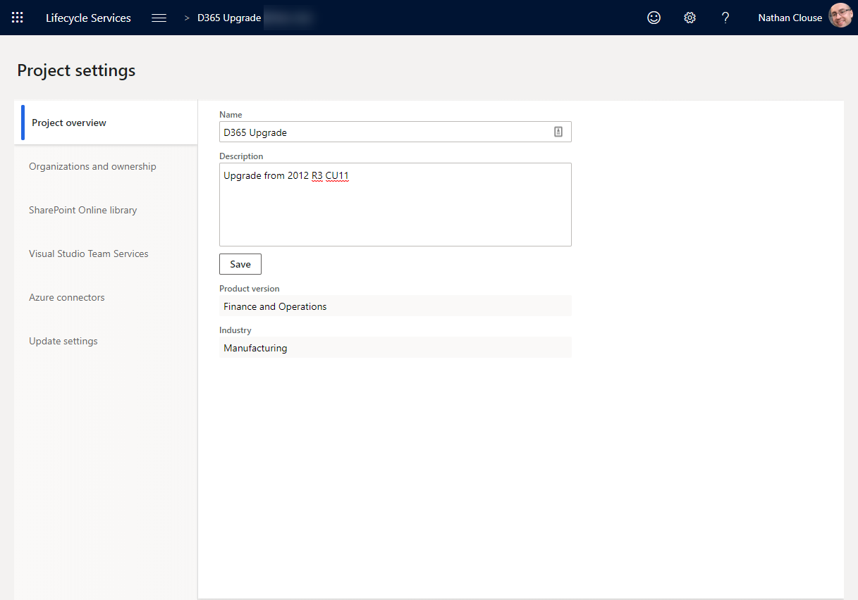
Project Settings

Slide 38
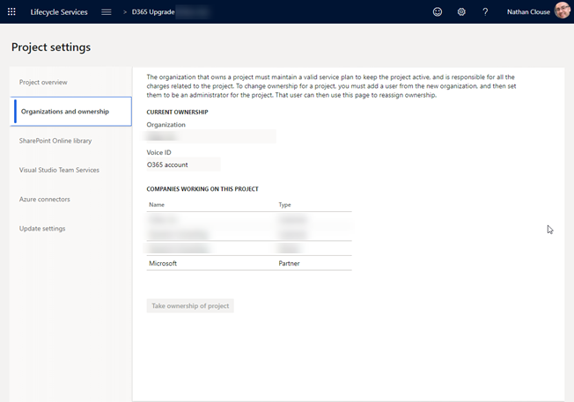
Project Settings - Organizations

Slide 39
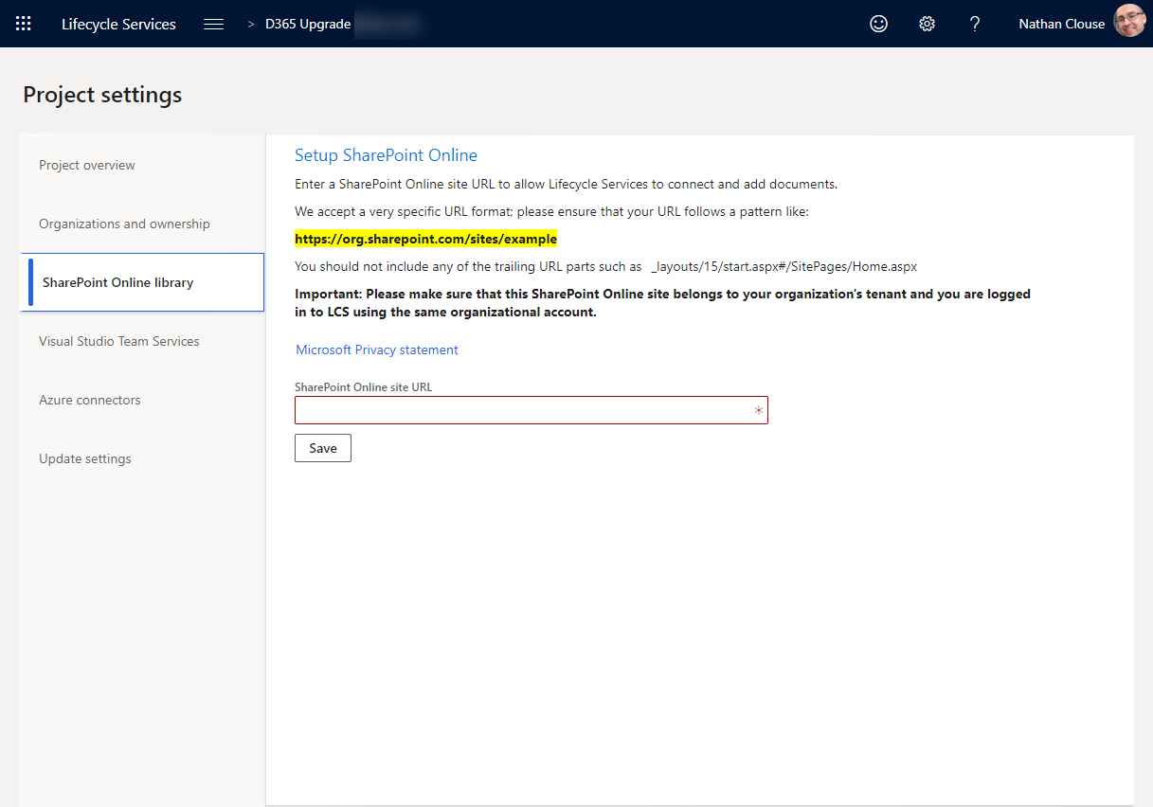
Project Settings - SharePoint

Slide 40
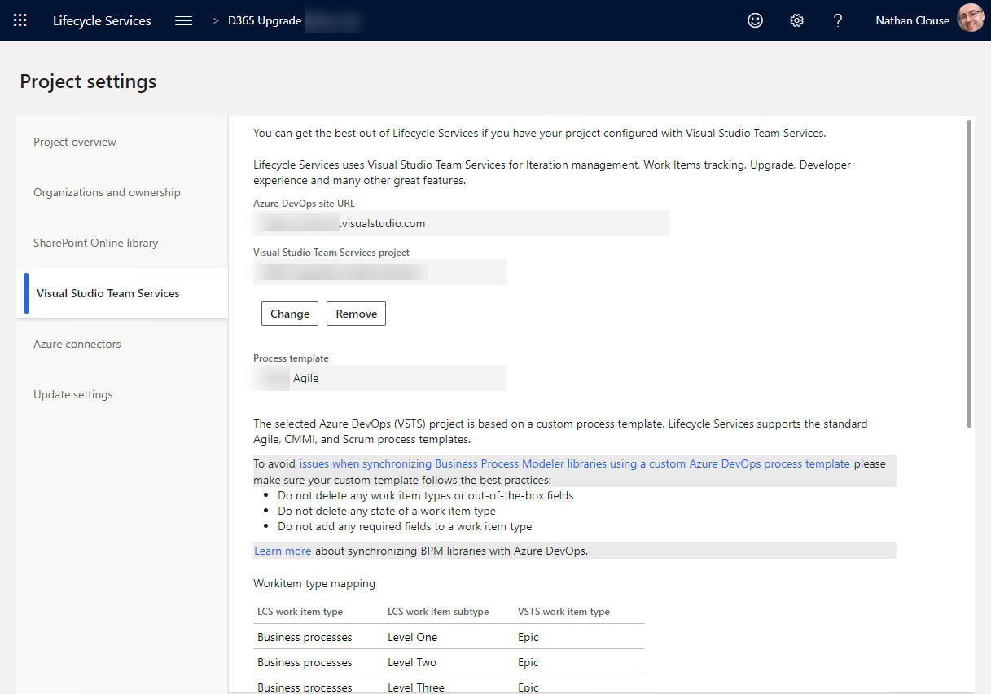
Project Settings – Azure DevOps (VSTS)

Slide 41
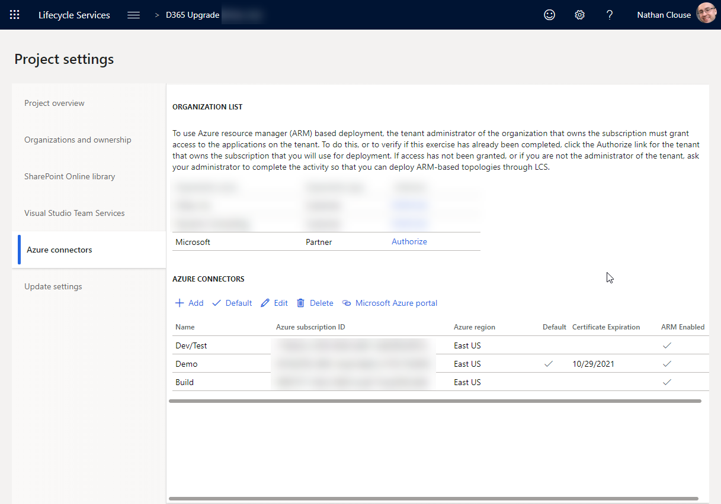
Project Settings – Azure Connections

Slide 42
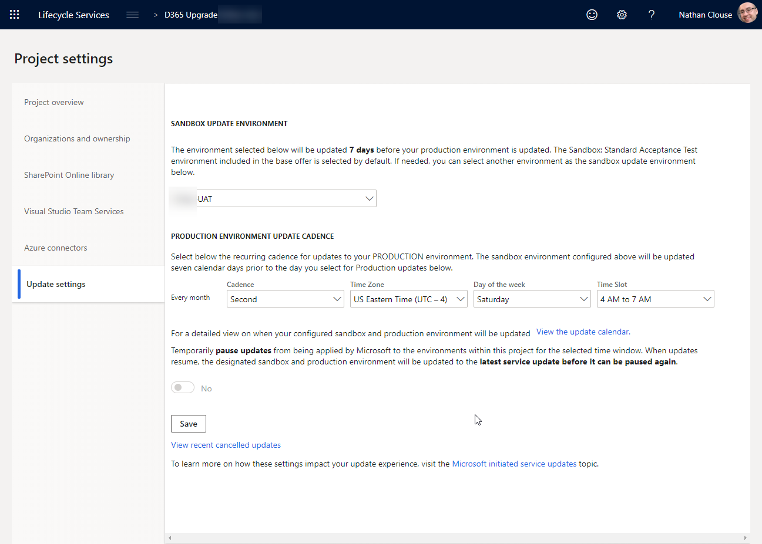
Project Settings – Update Settings

Slide 43
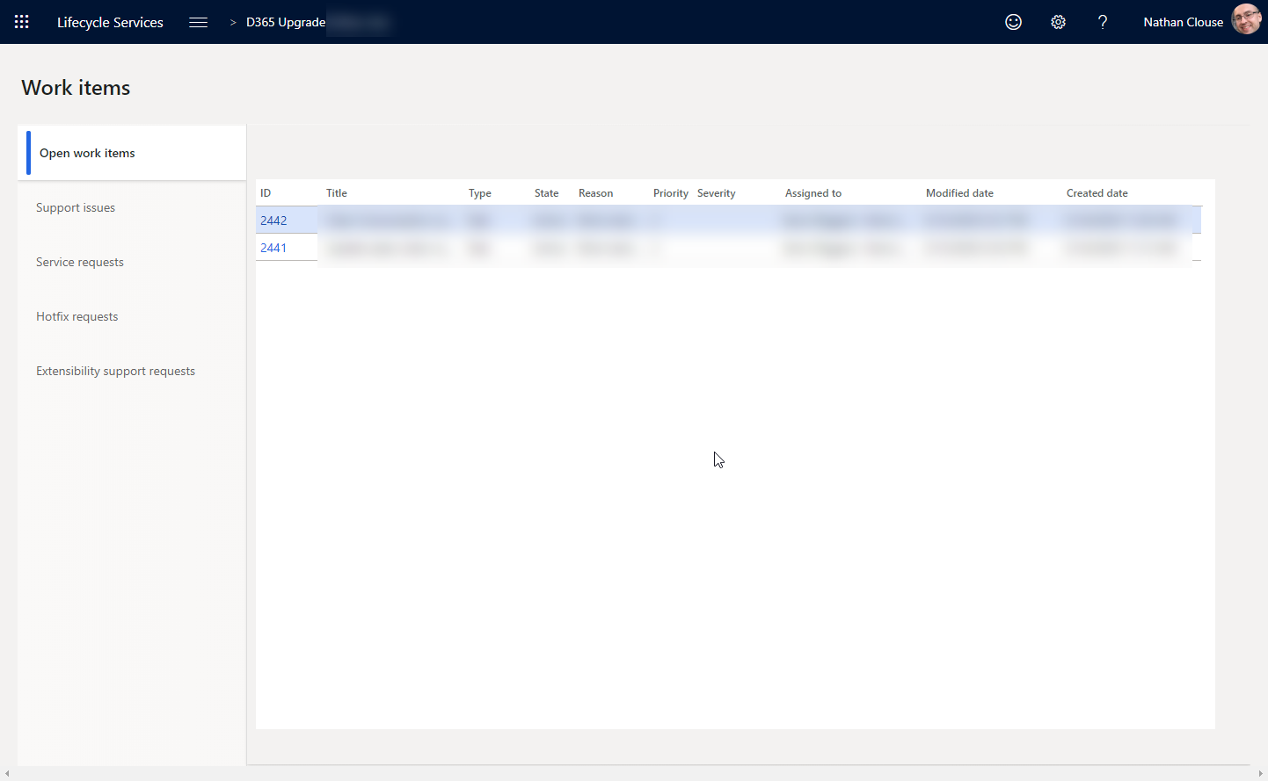
Work Items – Open Work Items

Slide 44
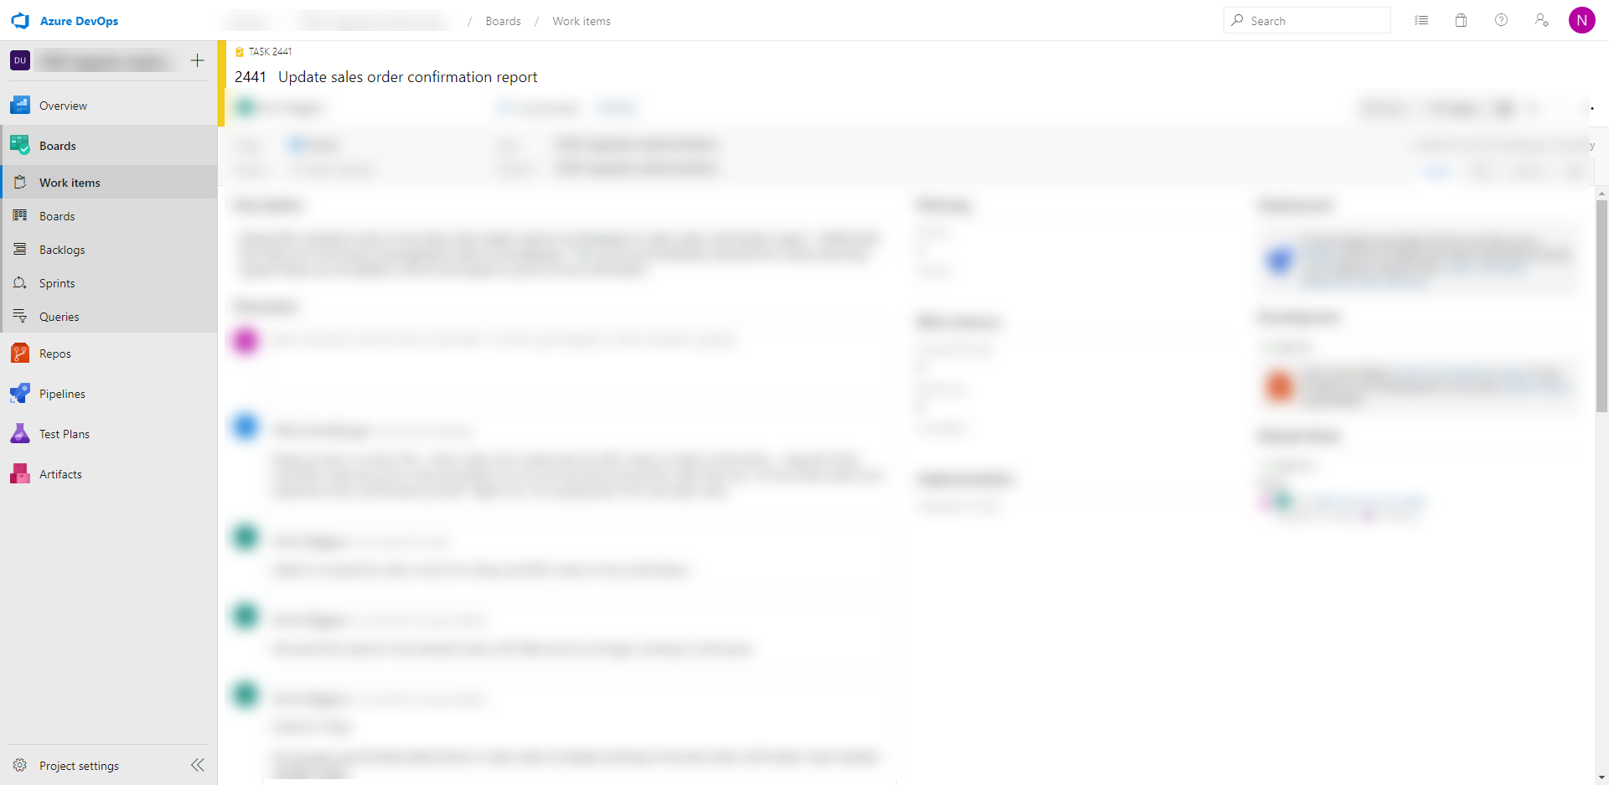
Work Items – Open Items (AZDO)

Slide 45
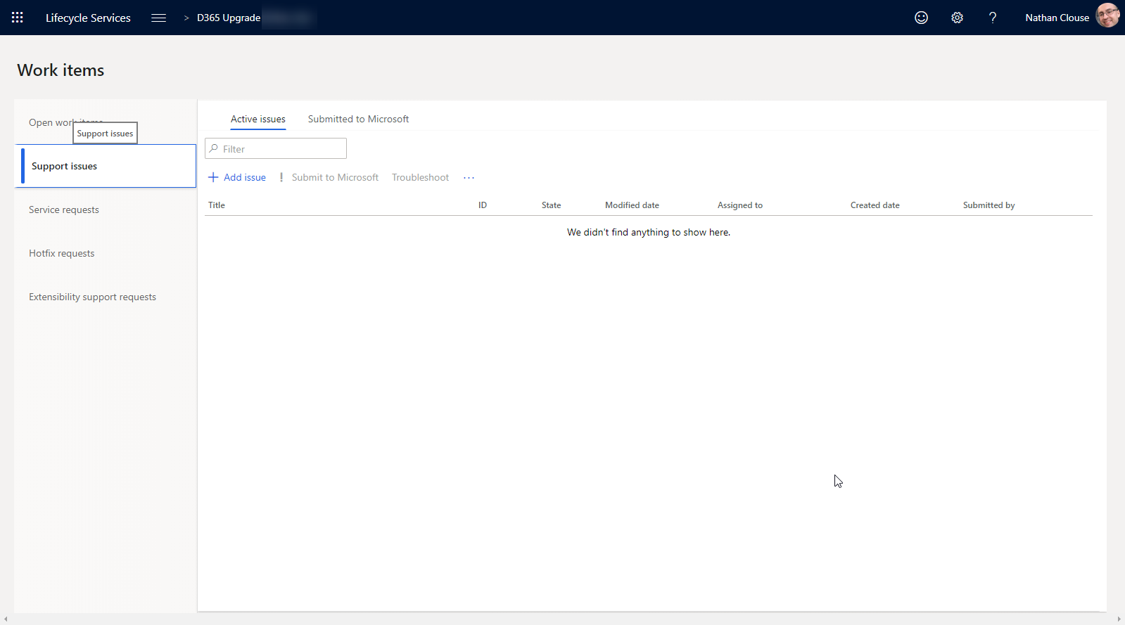
Work Items – Support Issues

Slide 46
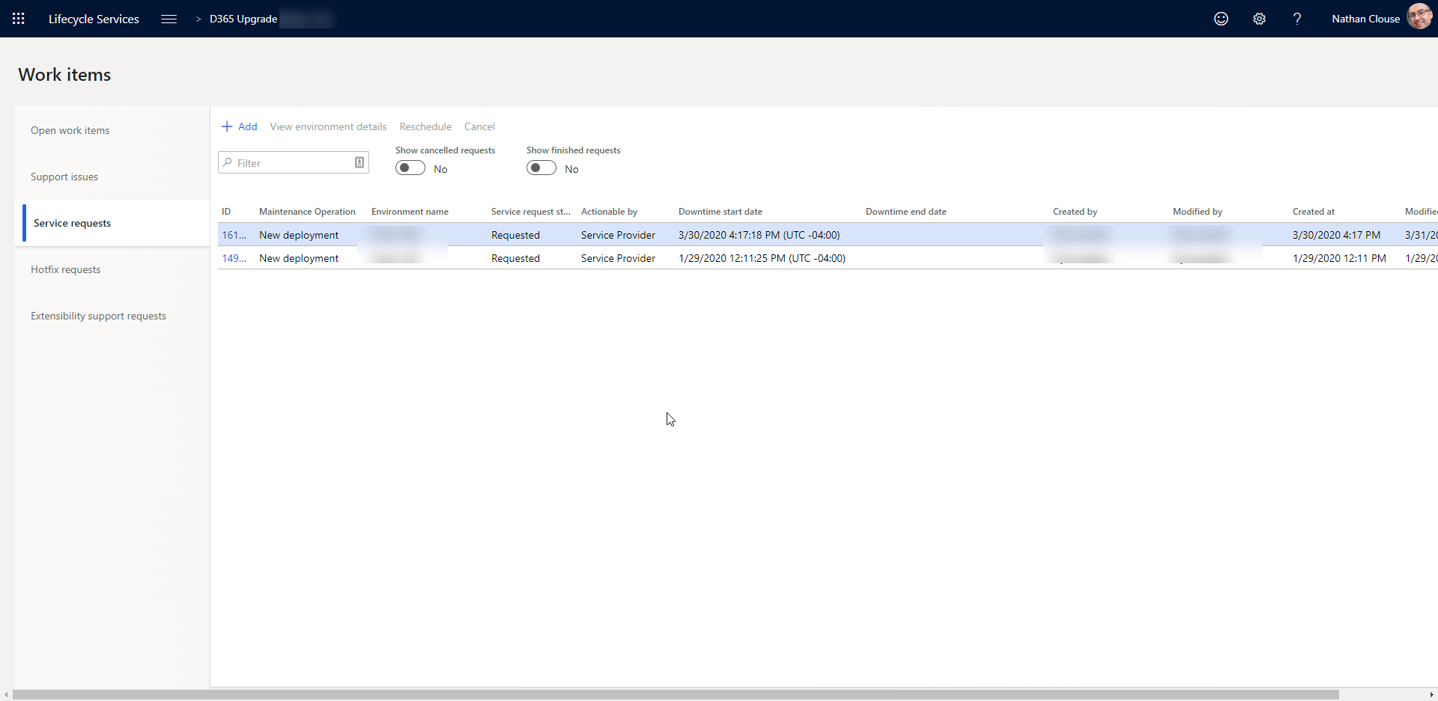
Work Items – Service Requests (DSE)

Slide 47
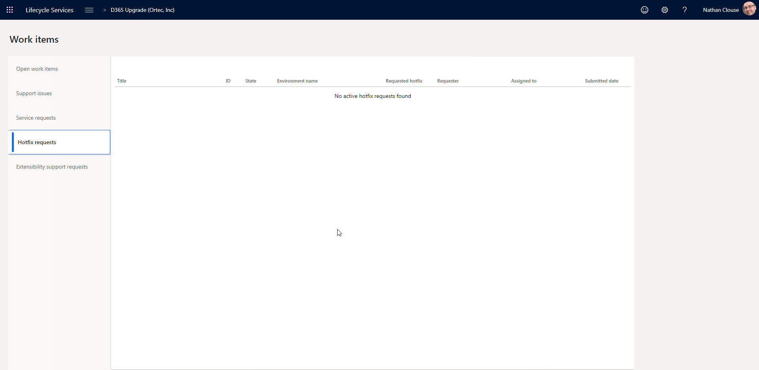
Work Items – Hotfix Requests

Slide 48
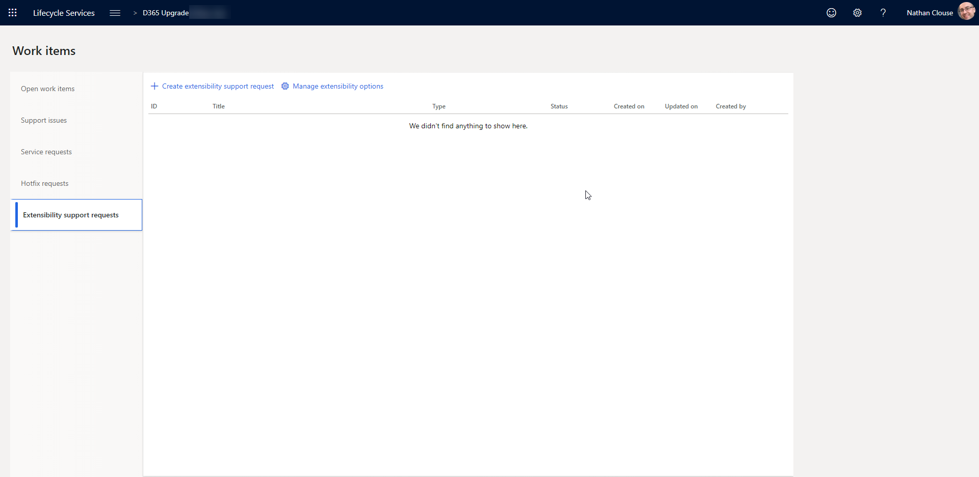
Work Items – Extensibility Support Requests

Slide 49
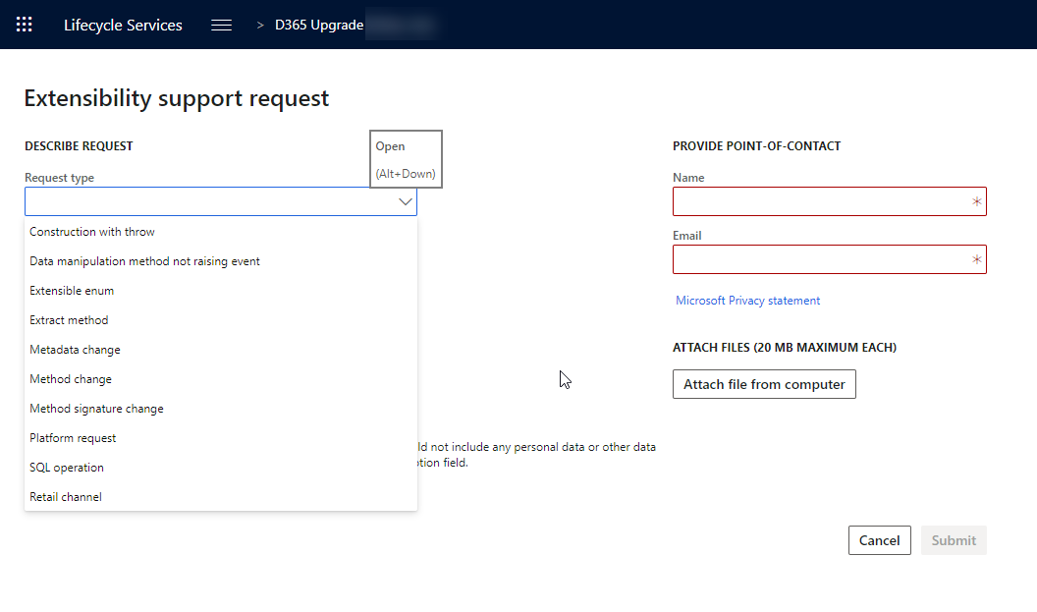
Work Items – Extensibility Support Requests

Slide 50
Topologies & Tiers

Slide 51
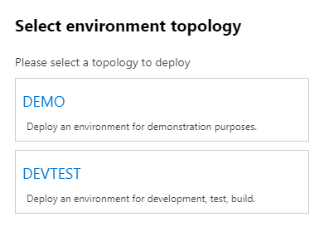
What is a topology?
Describes the composition of the environment
Develop
Build and Test
Standard Acceptance Test
Demo
Operations (Production)

Slide 52
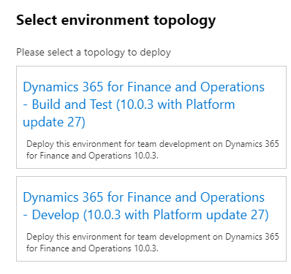
What is an environment purpose?
Why it exists – what it is for
Development
System Test
UAT
Performance Test
Training
Operations

Slide 53
What is a tier?
Describe the scale or size of the environment
Tier 1 – 5
1 is the smallest
5 is the largest
Sizing to tier is relative and does not translate to exact number of specific with specific roles
I.e.; T5 could be 20 or 50 AOS servers
Sizing worksheet (Don’t forget it)
Notes:
who actually shot first? han solo

Slide 54
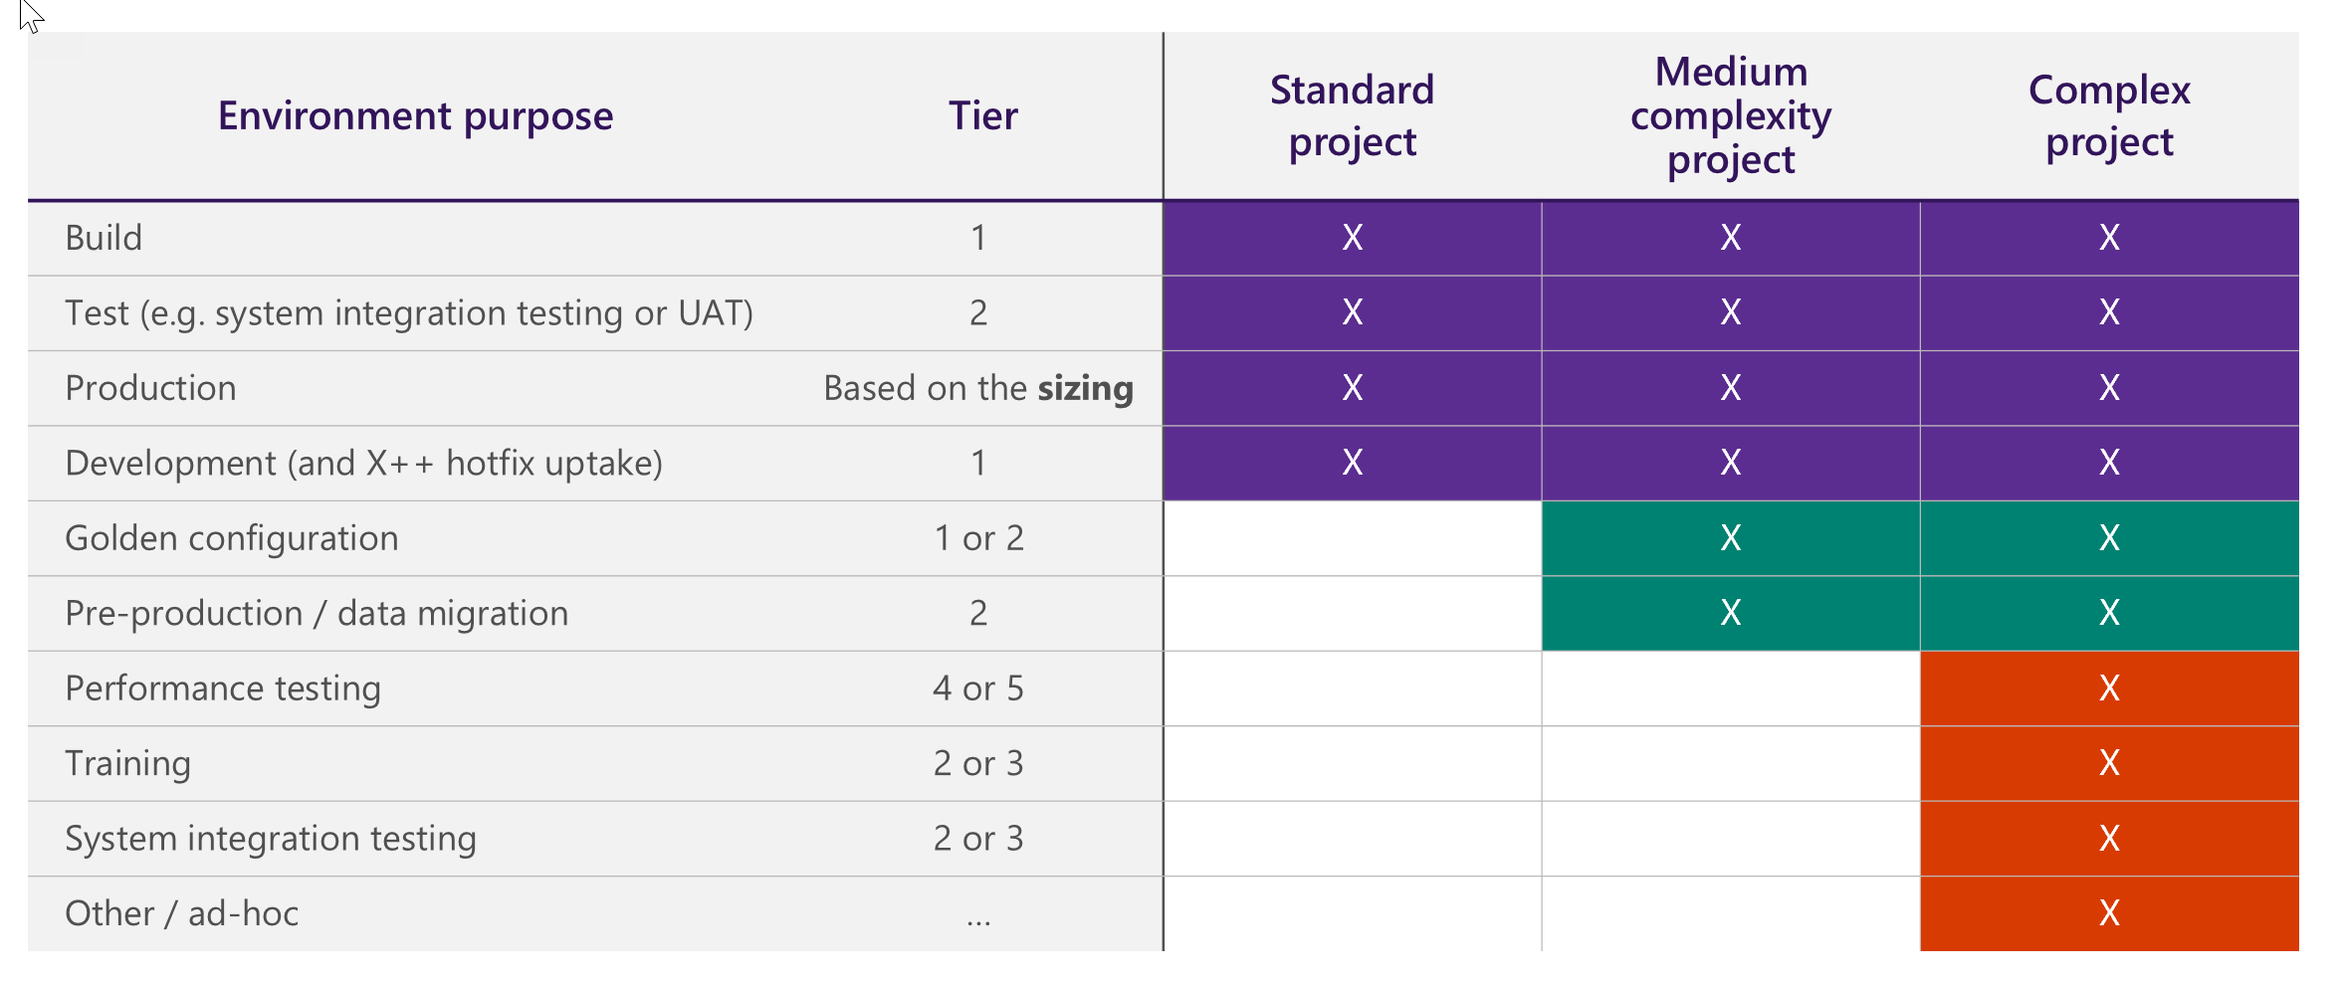
Tier Chart

Slide 55
What is an environment type?
Standard
Included as part of license, no separate cost
Managed by Microsoft
Includes
Production
UAT (Tier 2)
Add-On
Not included as par to of license
Additional SKU billed annually based on EA
No Azure cost
Managed by Microsoft
Example
an add-on environment might be an additional Tier-4 environment for performance testing.

Slide 56
What is an environment type? (cont.)
Cloud-Hosted
Not included in licensing
Additional Azure cost billed at standard rates
Not managed by Microsoft
Can be used for Demo, Development or Build purposes
Environment Image (VHD)
Hosted On-premise
Hyper-V VHD
Published by Microsoft on LCS in the Spring and Fall
Can be run from local laptop or integrated into large local virtualization platform

Slide 57
Available Topologies
Develop for T1 “Onebox”
Build and Test for T1 “Onebox”
Sandbox for T2+
Operations for T2+
Notes:
what type of droid is R2D2 classified as? astromech droid

Slide 58

Major Tier Differences

Slide 59
Design Time vs Run Time
Design time
Has source code
Can develop here
Easy to debug
Runtime
Has binaries from code – compiled code
Cannot develop here but better performance
Can debug but not as easy – can be involved

Slide 60
Azure & Environments

Slide 61
The cloud costs money
Reduce waste
Size appropriately
Easy to over size to review periodically
Allocate machines to individuals
If for development, make them a contributor on that machine so they can manage its uptime
Use Tags in the Azure Portal
Create 1 Azure Subscription per person to more easily review development costs

Slide 62
Schedule
Auto Shutdown
You can set auto shutdown times with email to webhook messages – send those to the assigned person
Start and Stop Scripts
Start and stop VMs at specific times
MSFT provides a tool to do this that requires some setup
Others have a free/paid service to help
Skyplug.io
VMPower.com

Slide 63

Schedule (cont.)
Use D365FOTools
https://github.com/d365collaborative/d365fo.tools
Example Commands
Invoke-D365LcsEnvironmentStart
Invoke-D365LcsEnvironmentStop
Lots of other great commands in this project

Slide 64
“Gotchas”
In Azure…
Shutdown does not mean no longer billing
Shutdown and deallocated means no longer billing
Managing availability and cost
Less about infrastructure
Notes:
THE MILLENNIUM FALCON, CAN COMFORTABLY FIT HOW MANY PEOPLE IN THE COCKPIT? Four

Slide 65
Provisioning

Slide 66
Provisioning
Orchestration of all environments, cloud or otherwise, is done though Life Cycle Services, or LCS.
https://lcs.dynamics.com
Use a generic account, like dynadmin@domain.com for management
Dynamics Service Engineer team commonly just called DSE.

Slide 67
By Type
Standard
Standard environments are managed via LCS. You create a request for the environment to be created which is then fulfilled and completed by DSE
Add-On
Same as standard after purchase and addition to LCS project.
Cloud Hosted
Entirely self-service.
On your Azure Subscription, LCS just orchestrates
All VMs created in a resource group for that VM
Can be on the same vNet if you want
Notes:
Standard
Standard environments are managed via LCS. You create a request for the environment to be created which is then fulfilled and completed by DSE (Dynamics Service Engineer) team commonly just called DSE.
Add-On
Same as standard after purchase and addition to LCS project.
Cloud-Hosted
Entirely self-service. Once you connect your LCS project to your Azure Subscription, you run through a wizard to create the VM and it submits the request to create that VM on your subscription with the specific options. If a new azure sub, request your core count be increase before provisioning your first VM. All VM resources are created in a resource group for that VM.

Slide 68
By Type (cont.)
VHD
Download from LCS. Go to Shared Asset Library > Downloadable VHD Files, download each file individually, unpack, open in Hyper V.
Production / Operations
Submit a request to DSE with your subscription estimation worksheet complete. Request will be reviewed and approved. MSFT may request additional info or provide feedback on your request.

Slide 69
Servicing

Slide 70

Classic with VMs

Slide 71

Service Fabric (Without VMs)

Slide 72

Maintain

Slide 73
Operations
Apply Updates
This is where you can apply various deployable packages. These could be custom code, from an ISV or from Microsoft. Deployable Packages Only
Messages Online users (VMs Only)
This will let you display a message to users who are active in the system. Typically, this is used to broadcast a system downtime message for people who are still active.
Upcoming Updates
Self-explanatory. You can see what is scheduled and when. If you wish to change the schedule, go to the hamburger > Project Settings > Update Settings

Slide 74

Apply Updates (Service Fabric)

Slide 75

Message Online Users (VMs Only)

Slide 76

Upcoming Updates

Slide 77
Operations (cont.)
Enable Access
This is where you will enable access to RDP to the various servers. This is an interface the change the firewall rules for the servers in that environment.
Restart Services
Here you’ll be able to start 1 of the following: Batch, DIXF, Reporting Server, LCS Diagnostics, IIS for VMs. Fewer for Service Fabric.
Move Databases
Several Options

Slide 78

Enable Access
Notes:
Only good for 8 hours
Only access to AQL

Slide 79

Enable Access
Notes:
Only good for 8 hours
Only access to AQL

Slide 80

Enable Access
Notes:
Only good for 8 hours
Only access to AQL

Slide 81

Restart Service (Service Fabric)

Slide 82

Restart Service (VMs)

Slide 83

Move Database

Slide 84

Operations – Move Database
Refresh Database
Import Database
Export Database
Point-in-Time restore Prod to Sandbox
Point-in-Time restore

Slide 85

Operations – Move Databases - Export
Export Database
Export database from a standard environment to the asset library

Slide 86

Operations – Move Databases - Import
Import Database
Import a database into a standard environment from the asset library

Slide 87

Operations – Move Databases - Refresh
Refresh Database
A database refresh lets you copy the transactional and financial reporting databases of your production environment into the target, sandbox UAT environment. If you have another sandbox environment, you can also copy the databases from that environment to your target, sandbox UAT environment.
Only between Tier 2 and above

Slide 88
Operations – Move Databases – Point in Time Restore Prod to Sandbox
Point-in-Time restore Prod to Sandbox
allows you to restore to a sandbox user acceptance testing (UAT) environment from a backup of production not in the asset library.

Slide 89
Operations – Move Databases – Point in Time Restore
Point In Time Restore
Allows you to restore a database for the given environment from a backup for that environment that is not hosted in the asset library.

Slide 90
Operations (cont.)
Enable Maintenance Mode
Enabled maintenance mode for allow for specific configurations and processes to complete that may drastically alter the functionality of the system.
Upgrade (VMs Only)
Only applicable to 7.3 environments or lower, basically N/A at this point.
Rotate Secrets
Tier 1 only - this means to regenerate and assign new certificates for the instance.
Notes:
Enable Maintenance Mode
Enabled maintenance mode for allow for specific configurations and processes to complete that may drastically alter the functionality of the system. For instance, enabling account structures. Only enable on request and disable once complete.
Upgrade
Only applicable to 7.3 environments or lower, basically N/A at this point.
Rotate Secrets
Only applies to cloud hosted environments as the other types have their certificates managed by MSFT. This means to regenerate and assign new certificates for the instance.

Slide 91
Servicing by Type – Non-Prod
Standard / Add-on
Largely Self Service now
On MSFT’s Azure subscription
Can stop / deallocate if you wish for VMs
Cloud-Hosted
Similar to Standard / Add-on but reduced overall LCS functionality
Can stop / deallocate from LCS or Azure Portal
VHD
Servicing is entirely manual via command line
Download from LCS update via scripts
Notes:
By Type
Standard and Add-On
Largely self service now. You can Deallocate and stop the environment if you wish. Standard environments are on MSFT’s subscription which is paid for by your licensing so there is no cost benefit to stopping environments. You can also apply updates, such as new code or updates from MSFT, message online users, view scheduled upcoming updated, if any, enabled RDP access by IP whitelist, restart various services, move databases, enabled maintenance and upgrade major version.
Cloud Hosted
Similar to standard but you can only apply updates, message online users and also rotate secrets
VHD
Servicing is all manual doing via command line. Code is installed manually and/or synced from Azure DevOps. Platform Updates are downloaded locally and installed via command line. Community module available to assist with this if needed – D365 Tools.

Slide 92
Servicing by Type - Prod
Production / Operations
All actions available as service requests
Fulfilled by DSE
Most commonly you would request a code deploy or a database operation

Slide 93

Servicing by Type – Prod (cont.)
Notes:
https://docs.microsoft.com/en-us/dynamics365/unified-operations/dev-itpro/lifecycle-services/submit-request-dynamics-service-engineering-team#service-request-types-and-slas

Slide 94

Servicing by Type – Prod (cont.)

Slide 95
Tear Down: Non-Prod
Cloud-Hosted
Deallocate then delete. All data are lost and all resources in VM resource group are deleted including resource group
Standard / Add-On
Deallocate then delete. Can re-provision once delete is complete. Slot remains if unused

Slide 96
Teardown: Production
Not Allowed
Entirely Managed by MSFT

Slide 97
Resizing
Cloud-Hosted
Resize the VM
LCS may not reflect the state of the VM
Standard / Add-On
For non-production, delete and re-provision
For Prod, create a request to re-evaluate usage based on licenses, increased functionality or seasonality
Notes:
What does AT-AT stand for? All Terrain Armored Transport.

Slide 98
Tools

Slide 99

Business Process Modeler (BPM)
Notes:
You can perform fit-gap analysis between your business requirements and the default processes in the Finance and Operations apps.

Slide 100
BPM Sync

Slide 101

BPM Library
Notes:
Add Process, customize library to your liking
Upload Task recording from inside

Slide 102

VSTS (Azure DevOps) Sync
Notes:
https://docs.microsoft.com/en-us/dynamics365/fin-ops-core/dev-itpro/lifecycle-services/synchronize-bpm-vsts
you can also track the progress of your implementation project in Azure DevOps, and can associate various work items with requirements and business processe

Slide 103

Upload Task Recording

Slide 104

Diagrams

Slide 105
Analytics, Diagnostics and Environment Monitoring

Slide 106

3 Options

Slide 107

Availability

Slide 108

Where to Find It - PROD

Slide 109

Where to Find It - UAT

Slide 110
System Diagnostics
Available in UAT / Sandbox environments plus PROD
Reports Server info
Failed jobs
Detected issues
High level overview of an environment

Slide 111
Environment Monitoring
Available in Prod and UAT only
High Scale, low latency
“hot path”
What’s going on right now
User Interaction
User load
Activity Load
SQL Insights
Review SQL level activity
Rebuild / create indexes
Review load and usage
Notes:
The User interaction chart shows a user's activities on various machines in the environment and the SQL utilization trend.
The User load section shows all the system users. Each chart shows the time that the user spent on a specific machine.
The Activity load section shows the activities that were performed on each machine. If you hover over an activity, you see the Form:Control:Action as a tuple. For example, if you look at LedgerJournal:New:Click in this section, you can see that user A opened the LedgerJournals page and selected the New button to create a new journal entry.
The User activity grid shows the various activities that users performed, based on their session timestamp.

Slide 112

Overview – 10 PM Friday Night

Slide 113

Overview – 10 AM Monday Morning

Slide 114

Index Analysis

Slide 115

Index Analysis - Details
Notes:
Seeks up, updates up, row counters fluctuation, index size fluctuation

Slide 116

Performance Metrics

Slide 117

Performance Metrics - Again
Notes:
Changed date/time range, got different results to review, look at timing to see outliers

Slide 118


(SQL) Actions
Notes:
Also Update Throttle Config on A table

Slide 119


Queries

Slide 120

Queries - Fragmentation
Notes:
Sorted by table name

Slide 121

Queries – Fragmentation
Notes:
Sort by fragmentation
2 outcomes, manually reorg it now to address issue that brought you here
Create support ticket with MSFt to more aggressively rebuild indices on schedule

Slide 122

Health Metrics

Slide 123


Activity

Slide 124
Recap
LCS Is central tool for managing Fin and Ops deployment and application lifecycle
If a new project, go through project onboarding and fill out subscription estimator
Review Tiers and Topologies as they use different technologies
Tier 2 and up is on Microsoft Tenant
Tier 1 is on your tenant and managed by you
Use slightly different tech
LCS has some great tools for upgrades and new implementations
Code Upgrade
Managed updates
Other Tools
Servicing to managing your environments
“Hot Path” Monitoring see what is happening in your environment now
“Warm Path” Diagnostics for interactive visualizations of environment activities
“Cold path” Analytics to review trends, app insights and reports

Slide 125
Questions?

